Slide 1


Why AmpleHarvest.org
Gary Oppenheimer • March 25, 2013
Founder, AmpleHarvest.org • gary@ampleharvest.org
“No food left behind”
http://www.flickr.com/photos/riebart/4882486655/
Notes:
Photo licensed under Creative Commons. http://www.flickr.com/photos/riebart/4882486655/

Slide 2

We are an exceedingly well fed, yet malnourished nation.
203 food banks provide processed food to 33,500 food pantries nationwide.
Canned produce with sugar or salt is what most pantry clients receive.
Existing food pantries lack the infrastructure to accept and store fresh food.
1 in 3 children today (soon, 1 in 2) will become diabetic*.
Malnourished children do poorly in school
Malnourished parents do poorly in the workplace.
Increasing numbers are unfit for military service*.
* Health and Human Services (HHS) and Whitehouse
Notes:
Photo licensed under Creative Commons - http://www.flickr.com/photos/uggboy/6910836875/

Slide 3
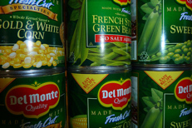

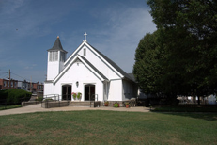

Donated Food
Food Conduit
Food Pantry
Canned food is accepted by food banks because pantries can store them without refrigeration.
Fresh food is rejected by food banks due to lack of refrigeration. We ship calories, not nutrition.
Today
Notes:
All pictures are Creative Commons
Canned Food picture: http://www.flickr.com/photos/krossbow/4477728568/
Warehouse picture: http://www.flickr.com/photos/toolstop/4324416999/
Food pantry (church): http://www.flickr.com/photos/baltimoreheritage/5071974494/
Garden basket: http://www.flickr.com/photos/pmarkham/1461014940/

Slide 4

40% of our food is never consumed.
An estimated 100B lbs. of food is lost yearly to waste
40M gardeners grow too much and dispose of their harvest
Notes:
National Resource Defense Council Report 2012

Slide 5
Donated Food
Food Conduit
Food Pantry
Growers: Working to educate, encourage and enable millions of growers (farmers too!) to donate excess garden produce using traditional and social media, faith community and direct outreach.
Technology: Function as a “Google” and clearing house for US Food Pantries. Connect growers with pantries, track success stories, and link to social media to generate awareness.
Pantries: One time registration to AmpleHarvest.org. Schedules drop-off with growers mindful of pick-up schedules. Brings fresh food to the communities that need it most. No logistics work by AmpleHarvest.org.
1
2
3
Proposal
Notes:
All pictures are Creative Commons
Canned Food picture: http://www.flickr.com/photos/krossbow/4477728568/
Warehouse picture: http://www.flickr.com/photos/toolstop/4324416999/
Food pantry (church): http://www.flickr.com/photos/baltimoreheritage/5071974494/
Garden basket: http://www.flickr.com/photos/pmarkham/1461014940/

Slide 6
Donated Food
Food Conduit
Food Pantry
AmpleHarvest.org is the Google of food. By directly connecting home gardeners with food pantries, we enable massive scalability of food distribution at a fraction of the operations cost thereby addressing the challenge of bringing nutrition to those who need it most.
Notes:
All pictures are Creative Commons
Canned Food picture: http://www.flickr.com/photos/krossbow/4477728568/
Warehouse picture: http://www.flickr.com/photos/toolstop/4324416999/
Food pantry (church): http://www.flickr.com/photos/baltimoreheritage/5071974494/
Garden basket: http://www.flickr.com/photos/pmarkham/1461014940/

Slide 7
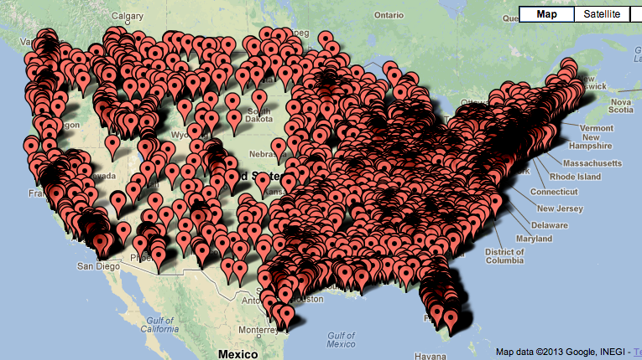
5,817 pantries registered to-date.
So what’s next?

Slide 8

AmpleHarvest.org needs to scale
There are 33,500 food pantries and 40M growers in the United States. To reach them, we need to scale our own operations.
AmpleHarvest.org needs to outreach
Reaching those 40M gardeners is going to require building content to reach them. Videos, posters, and other traditional media will require budget.
AmpleHarvest.org needs technology
The heart of AmpleHarvest.org is technology. Connecting gardeners with pantries will require a modern web site suitable for connecting everyone and tracking their success.

Slide 9












There is clear need
33,500 food pantries
203 food banks
Nearly 0 fresh fruit/vegetables
Yet 40% of our crop is waste
That is 1 lbs/person, per day
There is clear support
Recognized on CNN
Repeat topic at TED
Topic for Whitehouse conference on food in the US
Google Grant recipient
Help us clear the path
Donated Food
Food Conduit
Food Pantry
Notes:
Photo licensed Creative Commons: http://www.flickr.com/photos/aaronmcintyre/8496724234/

Slide 10
Gary Oppenheimer
Founder and Executive Director
gary@ampleharvest.org • www.ampleharvest.org
+1-267-536-9880

