Slide 1


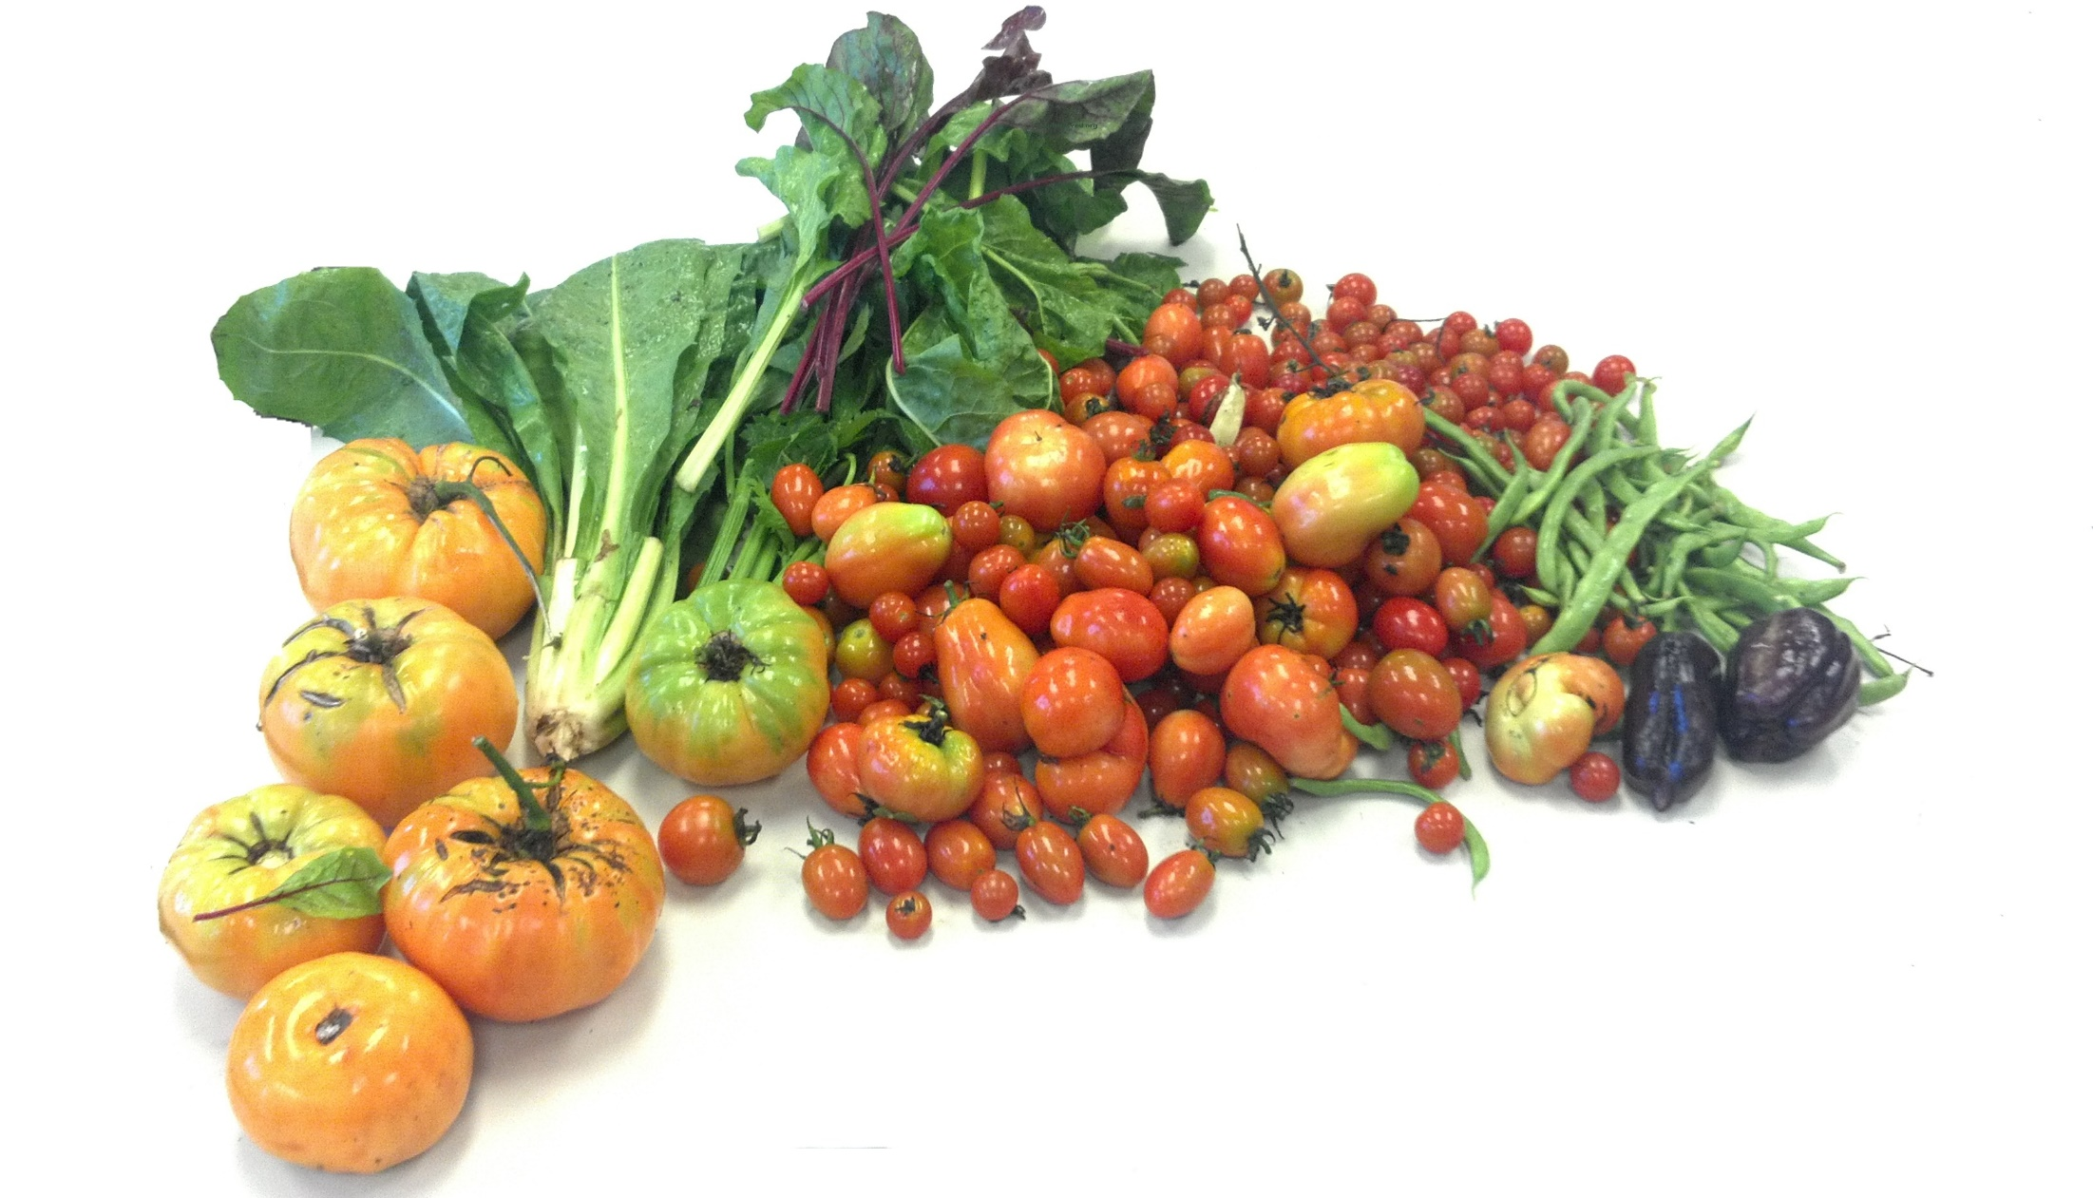
AmpleHarvest.org & Feds Feed Families
Gary Oppenheimer
gary@AmpleHarvest.org

Slide 2
AmpleHarvest.org & Feds Feed Families
America’s Gardeners
(especially federal employees)
Ending Hunger & Food Waste
Gary Oppenheimer
gary@AmpleHarvest.org

Slide 3
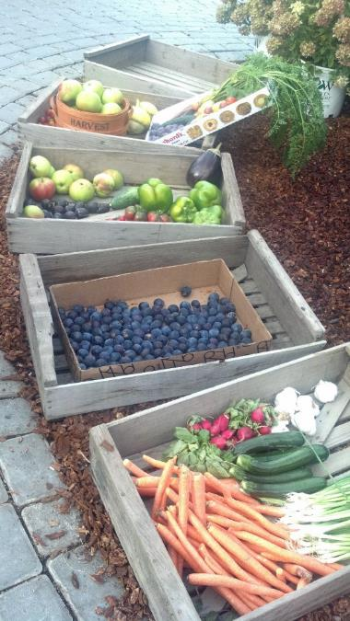
AmpleHarvest.org is a nationwide 501c3 non-profit running a 50 state program ending hunger and the waste of food from 62 million home and community gardens.

Slide 4
In EVERY Community In America
There Are Two Audiences....

Slide 5
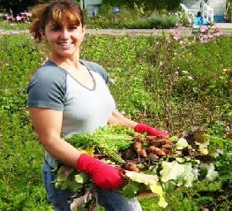

42 62! Million Home & Community Gardeners
40% of All Households

Slide 6

2.1 million Federal Employees
840,000 Home & Community Gardeners

Slide 7
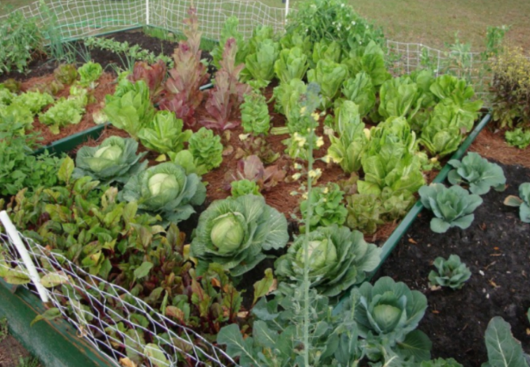
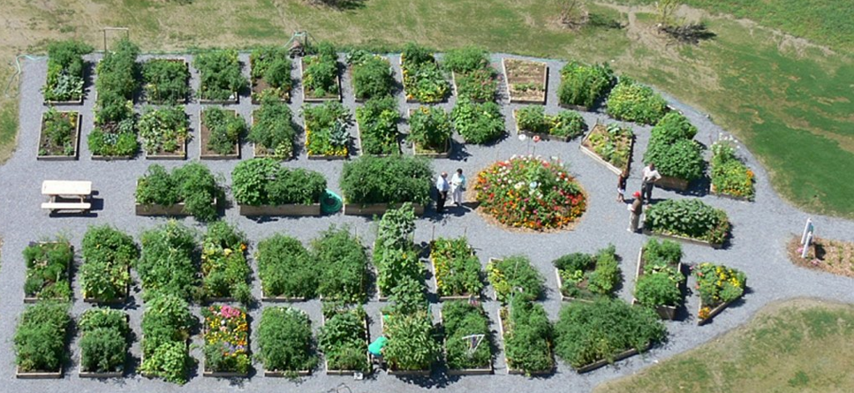
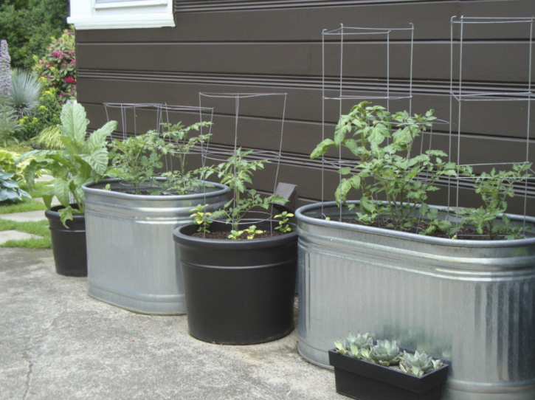
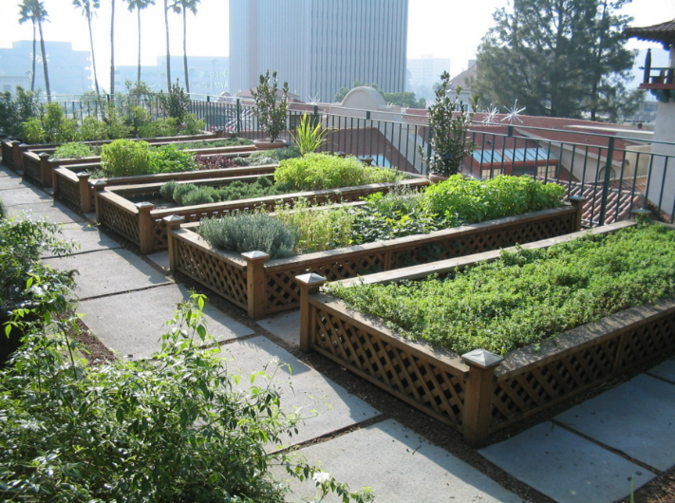
Home Gardens
Community Gardens
Container Gardens
Roof Top Gardens

Slide 8

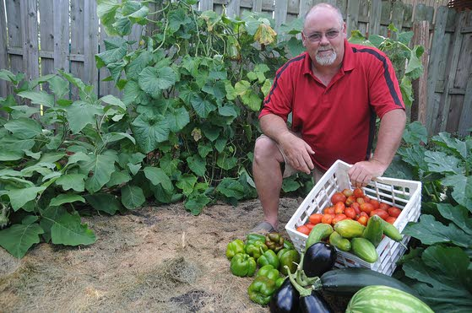

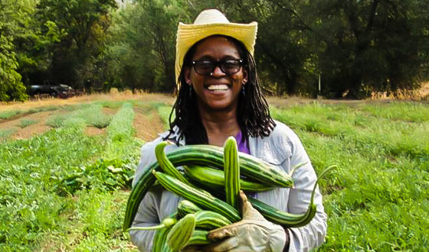
Gardeners Harvest Enough Surplus To Feed 28 Million People

Slide 9



40 42! million food insecure people

Slide 10

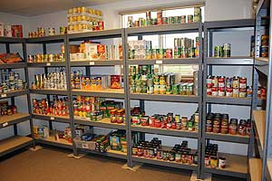

Slide 11


Slide 12

Hunger In America
Isn’t Due To A Lack of Food
It is Due To
Misinformation and Missing Information

Slide 13




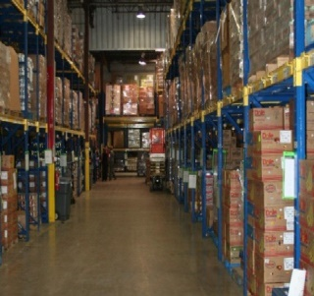


The past:
“Jars, Cans, Boxes – No Fresh Food”
Chokepoint in our food system
42M Hungry People
203 Food Banks Nationwide
33K Pantries
Time
X

Slide 14

“Jars, Cans, Boxes – No Fresh Food”
Chokepoint in our food system
42M Hungry People
203 Food Banks Nationwide
33K Pantries
Time
X

Slide 15
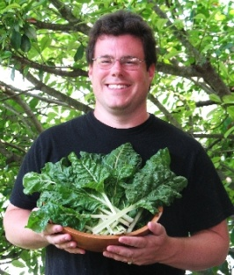


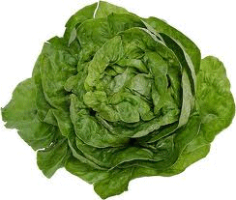



62M home growers
Find A Nearby
Pantry
Register to be Searchable
42M Hungry People
42M Hungry People
33K Pantries
203 Food Banks Nationwide
Time
X

Slide 16
62M home growers
42M Hungry People
42M Hungry People
33K Pantries
203 Food Banks Nationwide
Time
X

Slide 17
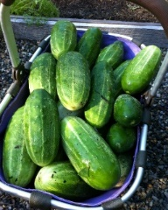
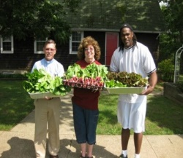
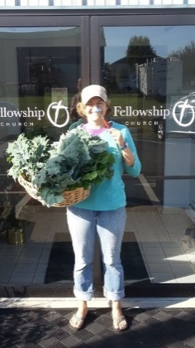
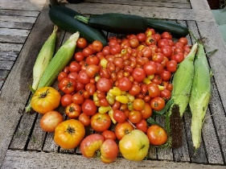
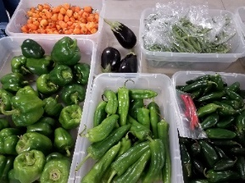
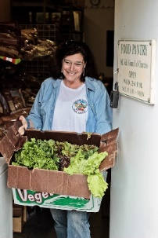

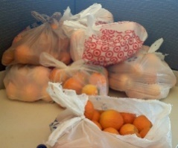
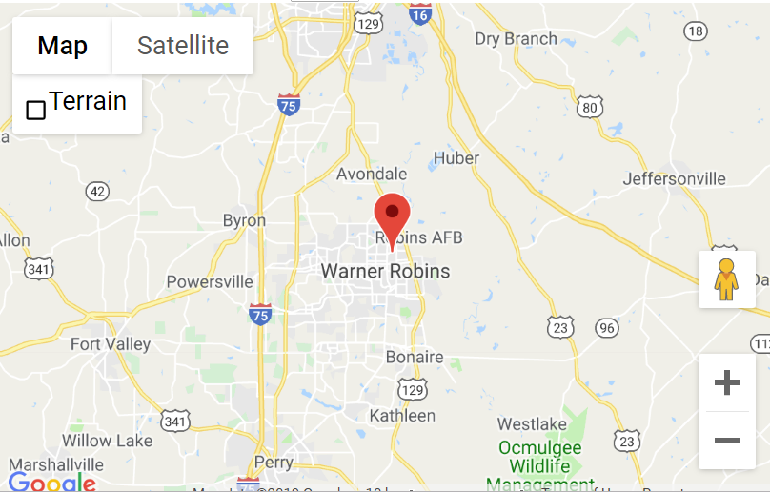


Anytown, USA
9 Mile

Slide 18
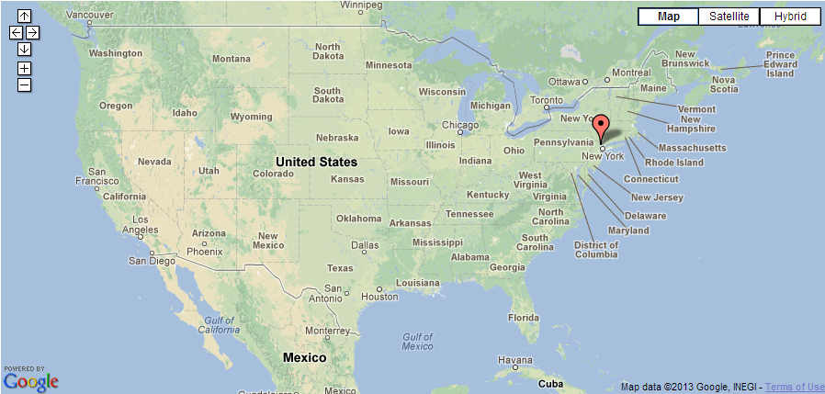
Is There An AmpleHarvest.org Food Pantry Near Me?

Slide 19
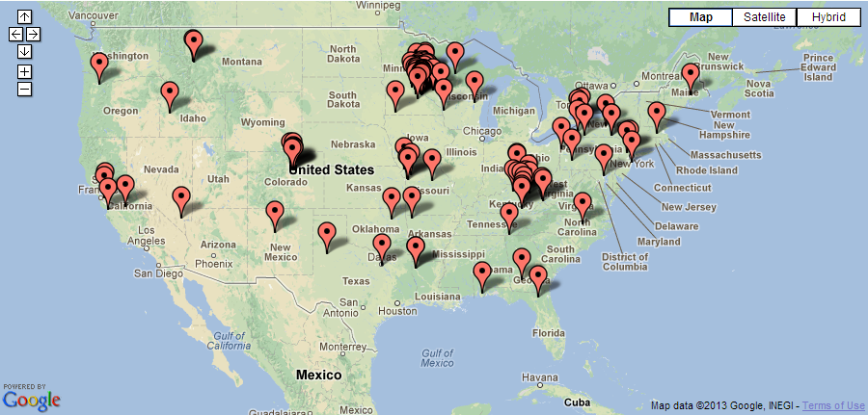
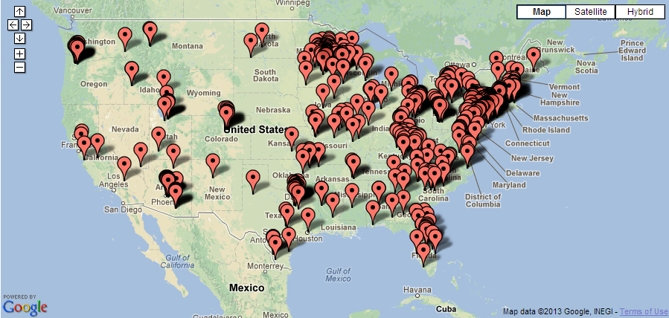
Is There An AmpleHarvest.org Food Pantry Near Me?

Slide 20
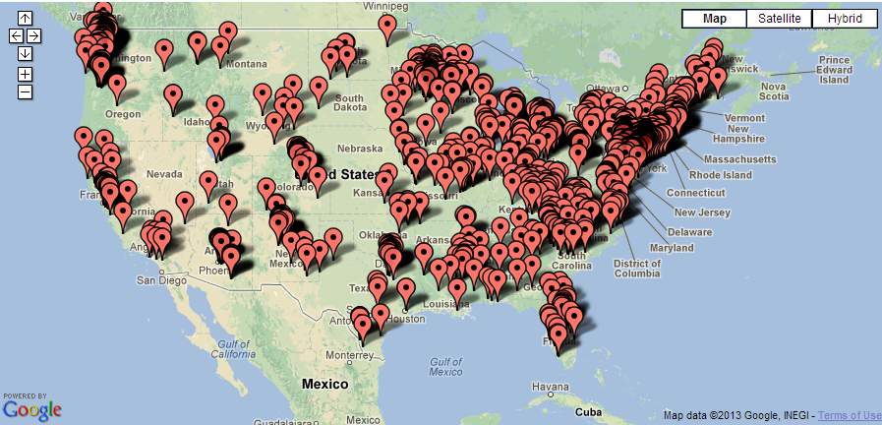
Is There An AmpleHarvest.org Food Pantry Near Me?

Slide 21
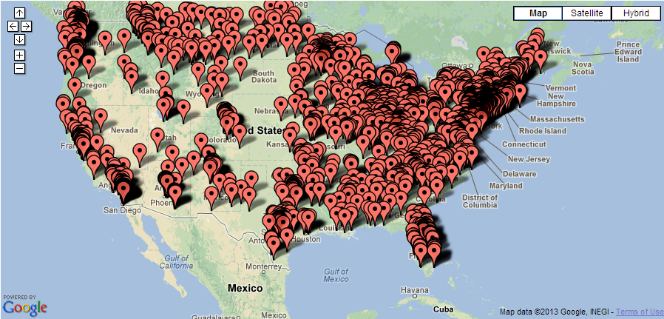
Is There An AmpleHarvest.org Food Pantry Near Me?

Slide 22
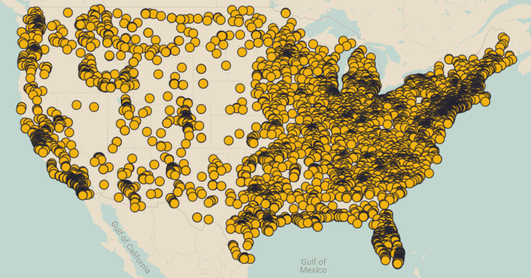
Is There An AmpleHarvest.org Food Pantry Near Me?
More than 8,000 food pantries
In 4,200 communities
Across all 50 states

Slide 23
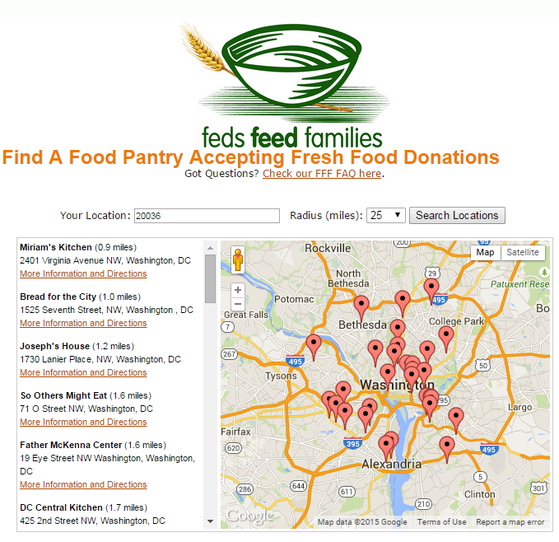
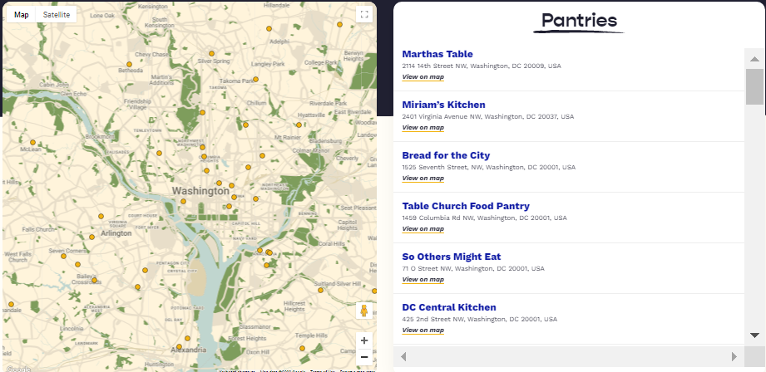
www.AmpleHarvest.org/FFF

Slide 24
www.AmpleHarvest.org/FFF
Click More Information and Directions

Slide 25
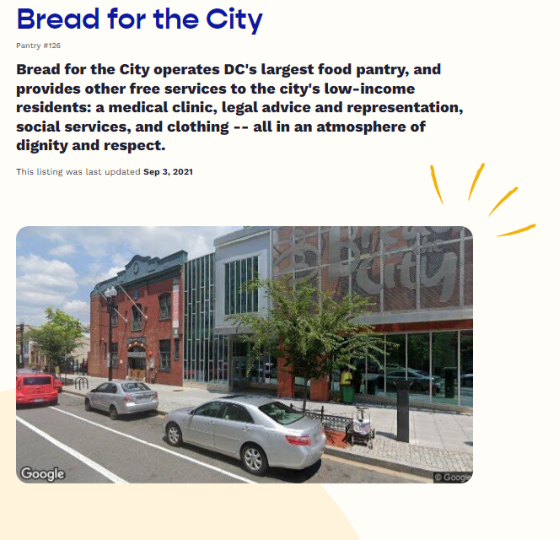
Pantry Description

Slide 26
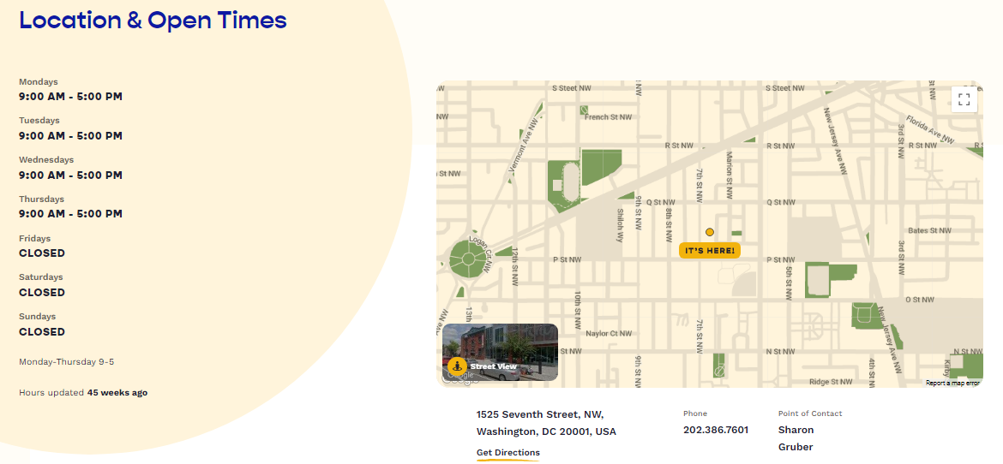
Pantry Location & hours

Slide 27


Slide 29




Slide 30

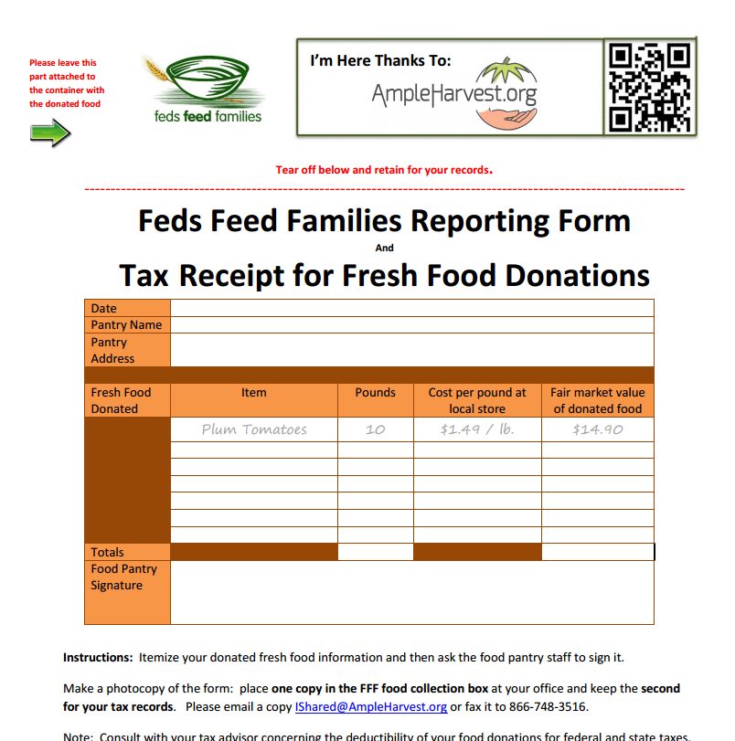
www.AmpleHarvest.org/FFF

Slide 31
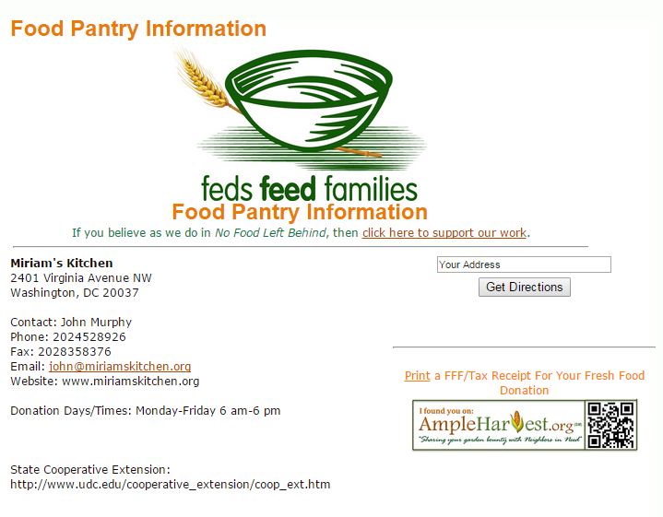
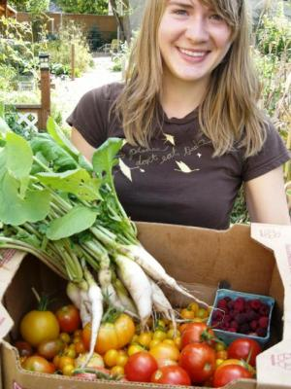
Take the food to the pantry when you harvest more than you can use, preserve or share with friends.
Continue for as many years as you continue to garden.

Slide 32


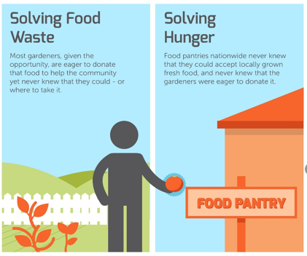


Slide 33
Important Points
No donation is too small
Fresh food donations protected by federal law
Donations can continue after FFF ends
Donations are tax deductible

Slide 34
More Important Points
COVID-19 safety guidance available
Social Distancing built into the model
Fresh food donations more important than ever for health, immunity and recovery
Promotes community engagement.

Slide 35
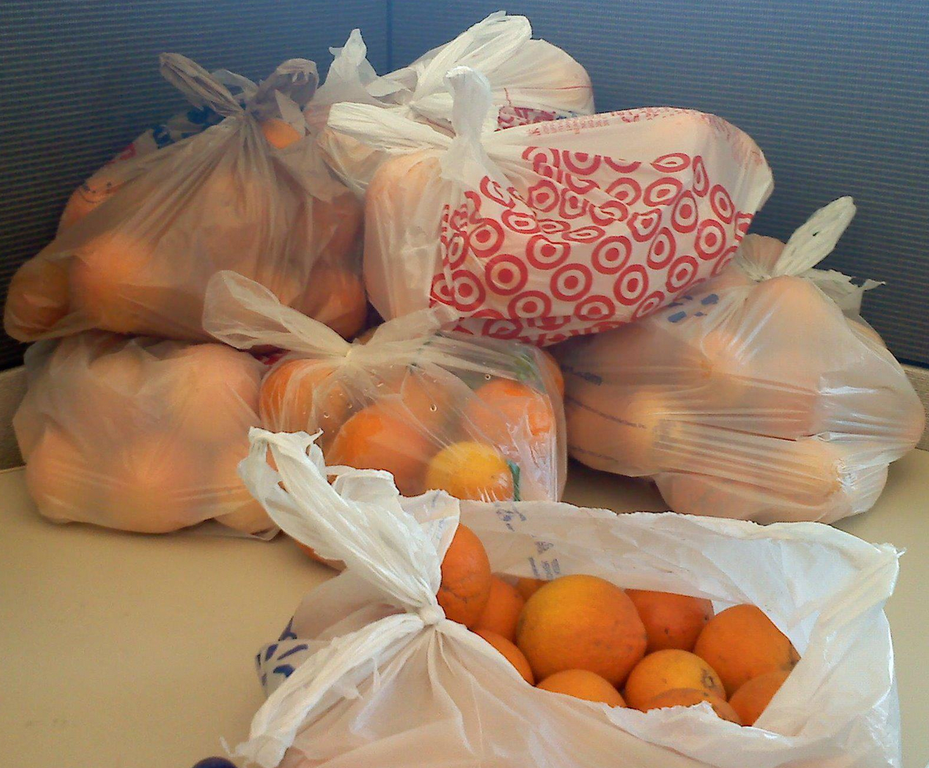
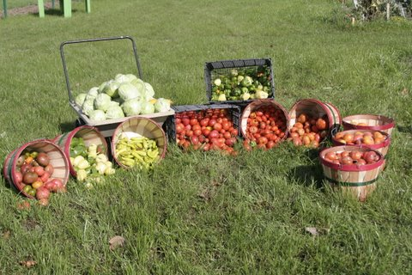
This Is “Food Waste”
Donated By A Home Gardener

Slide 36
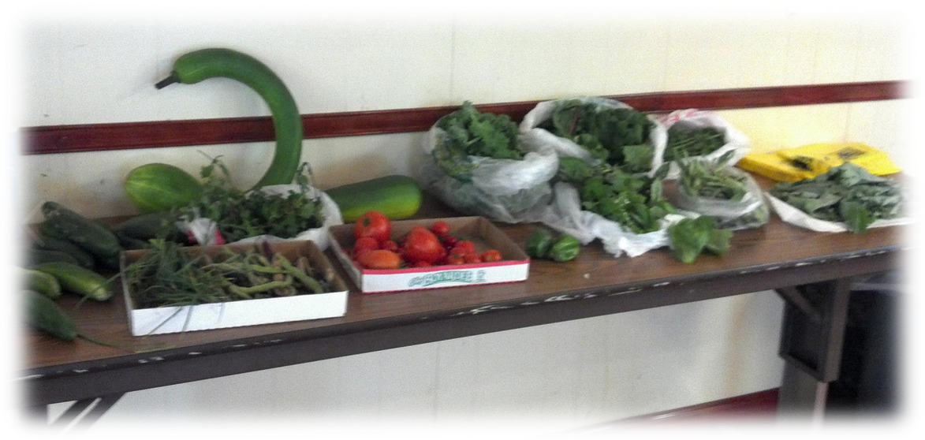
This Is “Food Waste”
Donated By A Home Gardener

Slide 37
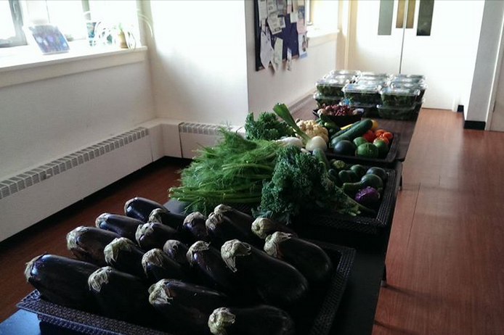
This Is “Food Waste”
Donated By A Home Gardener

Slide 38


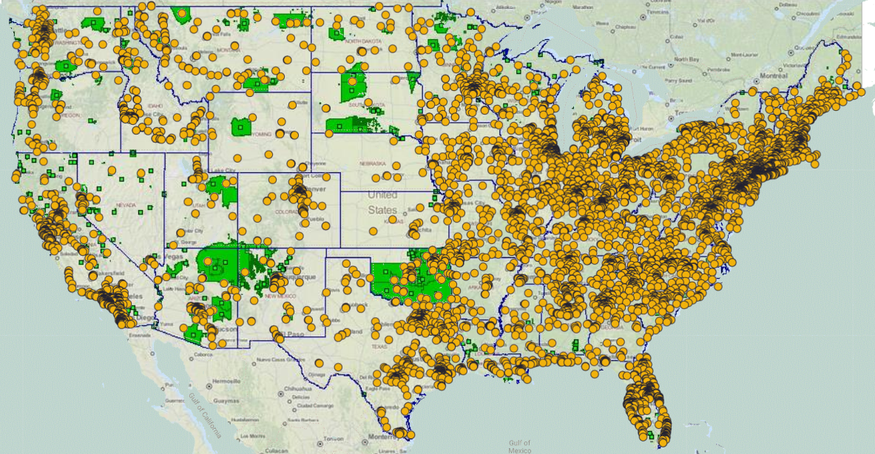

Slide 39




Slide 40



Slide 41
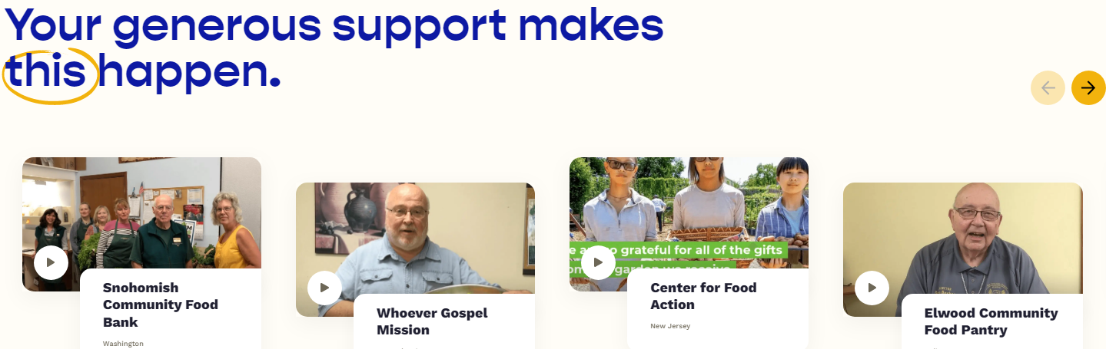
Visit www.AmpleHarvest.org/impact

Slide 42
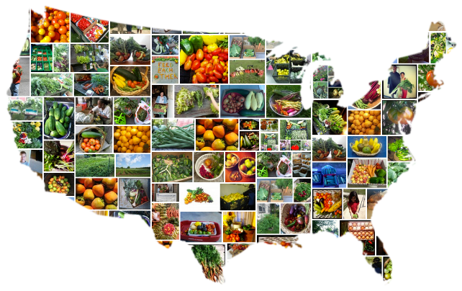

Additional Resources
Looking to start gardening or expand your garden?
Bonnie Plants and AmpleHarvest.org have the perfect solution for you:
www.AmpleHarvest.org/BonniePlants
Looking to help more food pantries in your community benefit from AmpleHarvest.org?
Visit www.AmpleHarvest.org/local
Questions?
Notes:
Jamie Oliver – TED speaker
First Lady Michelle Obama – Lets Move
Michael Pollan – Author
For the millions of Americans who can’t afford healthier eating, ampleharvest.org is enabling what they advocate

Slide 43
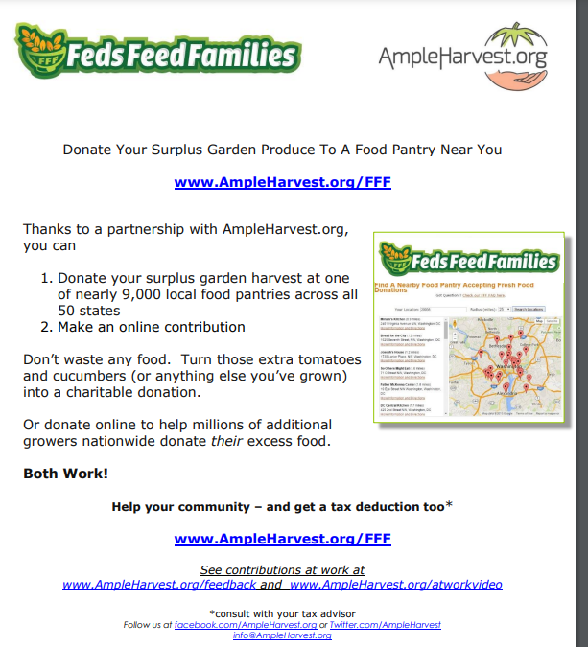
For FFF Champions:
Guide: AmpleHarvest.org/FFFposter

Slide 44
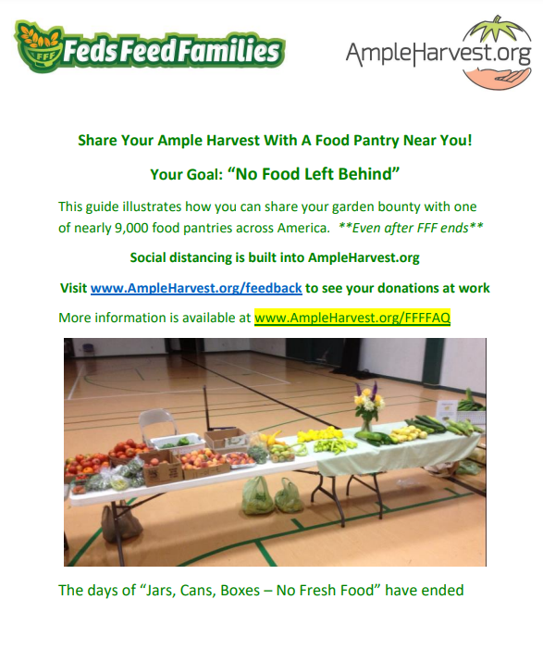
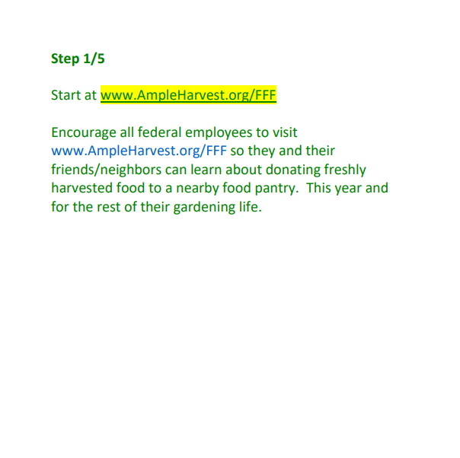
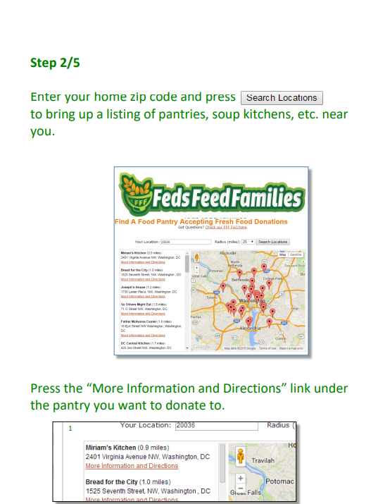
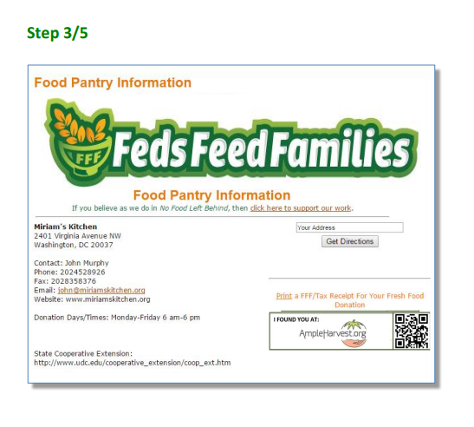
For FFF Champions:
Guide: AmpleHarvest.org/FFFguide

Slide 45
For FFF Champions:
Guide: AmpleHarvest.org/FFFguide
Office Poster: AmpleHarvest.org/FFFposter
For ALL Growers
Donating Food: AmpleHarvest.org/FFF
FAQ: AmpleHarvest.org/FFFFAQ
Reporting Donations: AmpleHarvest.org/FFFreport
Learn More at
AmpleHarvest.org/TED & AmpleHarvest.org/CNN
Questions?

