Slide 1

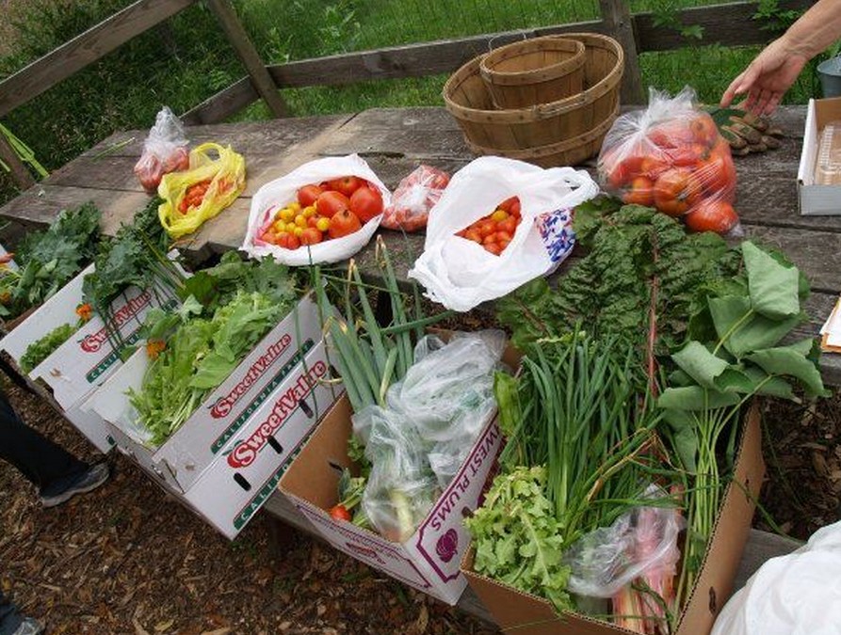
In the past, this would have been wasted food

Slide 2
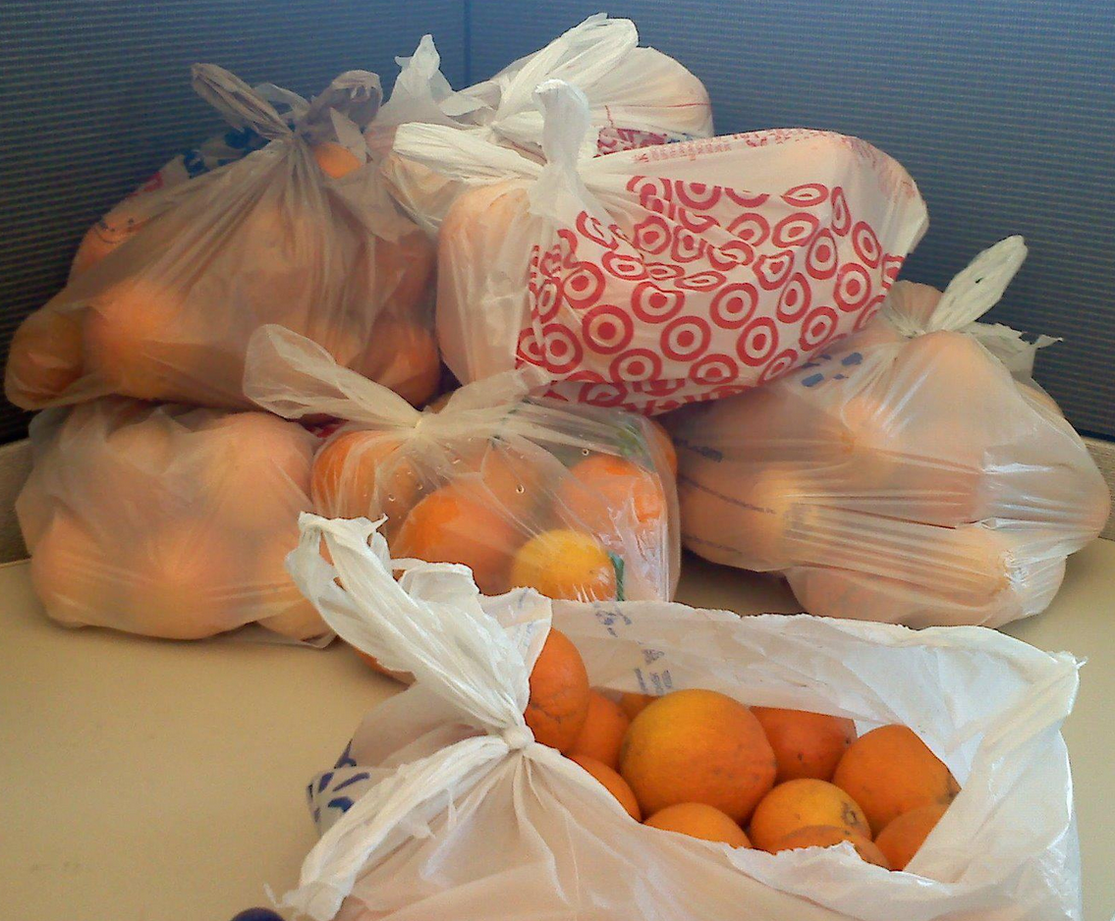
In the past, this would have been wasted food

Slide 3
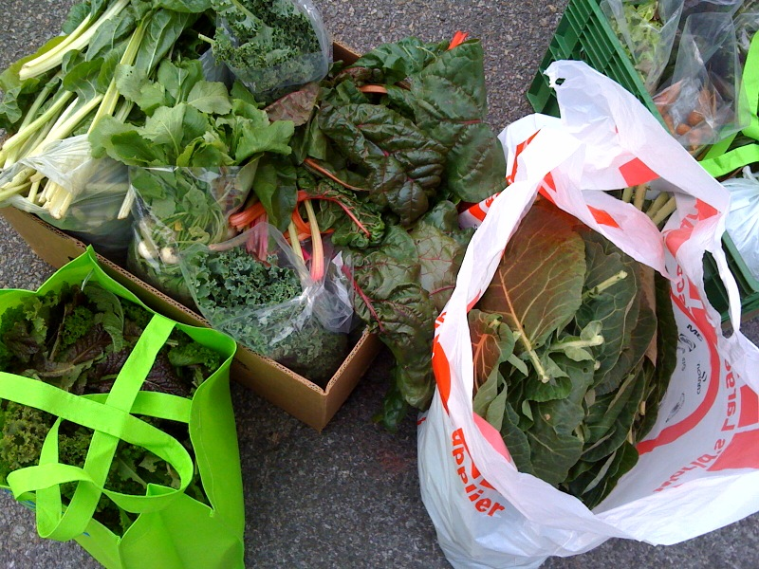
In the past, this would have been wasted food

Slide 4
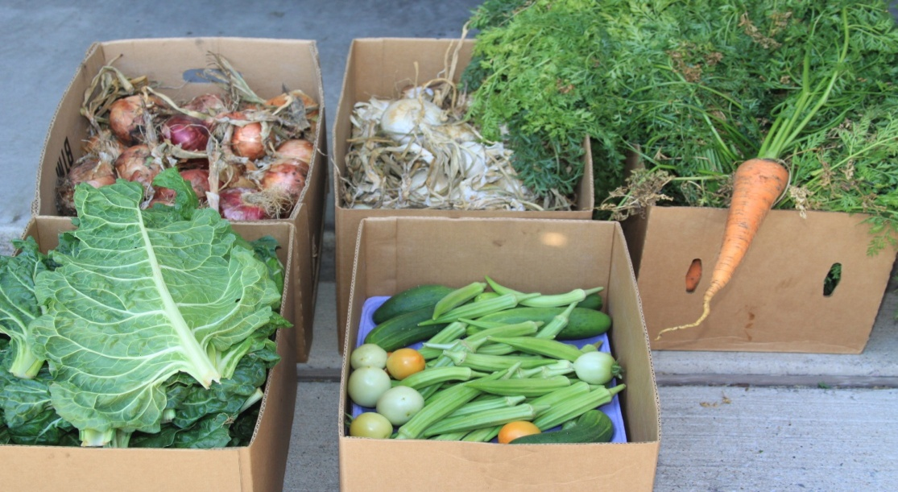
In the past, this would have been wasted food

Slide 5
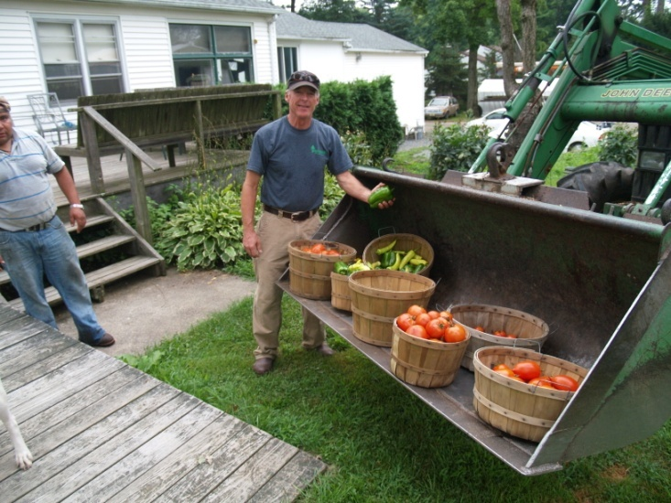
In the past, this would have been wasted food

Slide 6
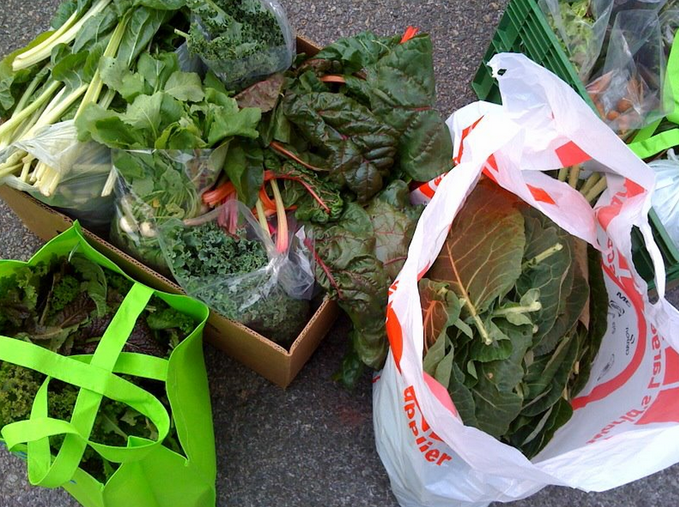
In the past, this would have been wasted food

Slide 7
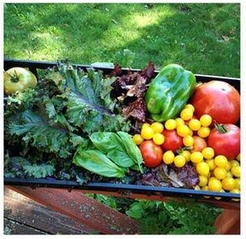
In the past, this would have been wasted food

Slide 8
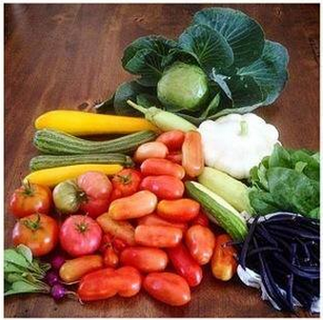
In the past, this would have been wasted food

Slide 9
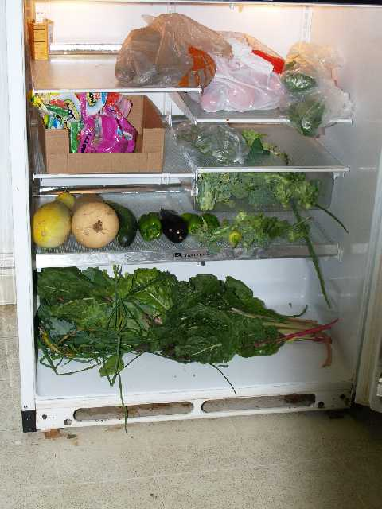
In the past, this would have been wasted food

Slide 10
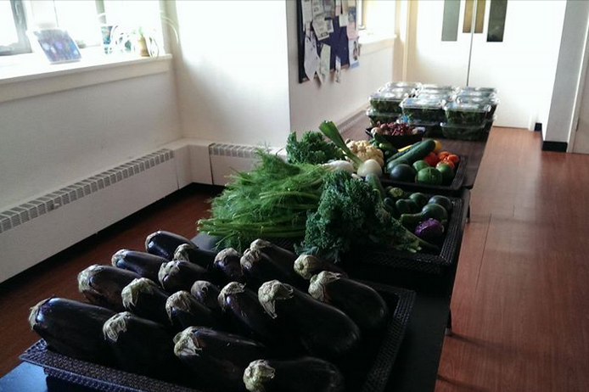
In the past, this would have been wasted food

Slide 11
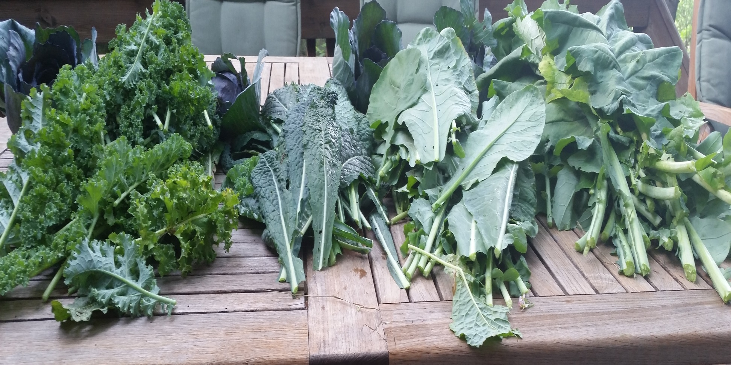
In the past, this would have been wasted food

Slide 12
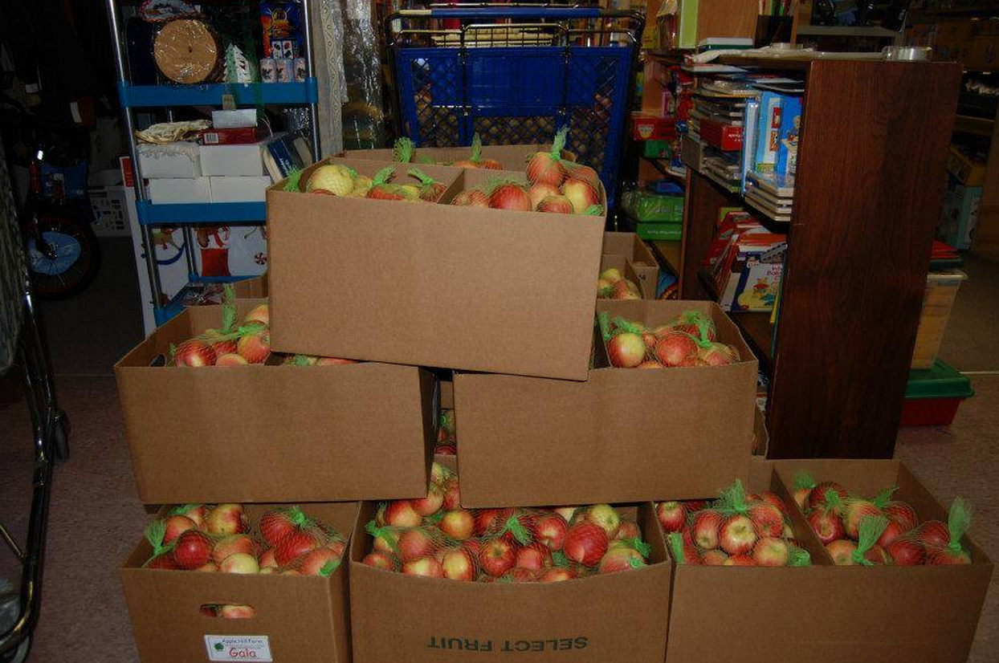
In the past, this would have been wasted food

Slide 13
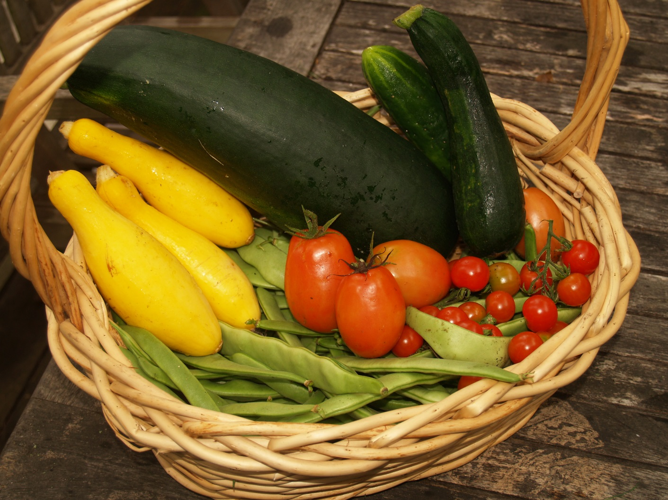
In the past, this would have been wasted food

Slide 14
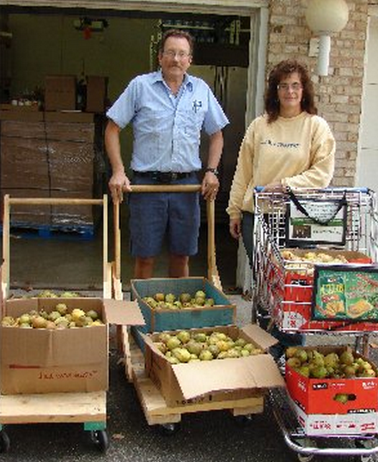
In the past, this would have been wasted food

Slide 15
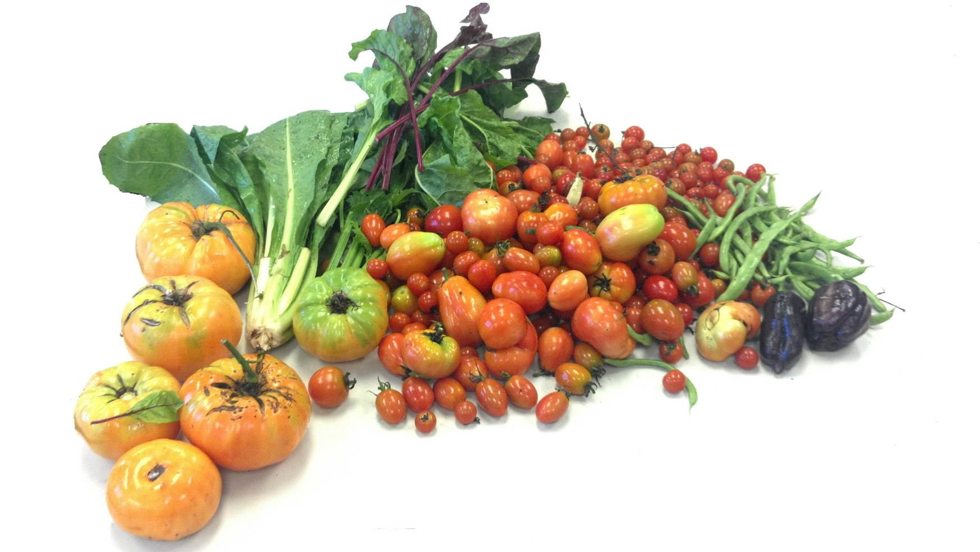
In the past, this would have been wasted food

Slide 16
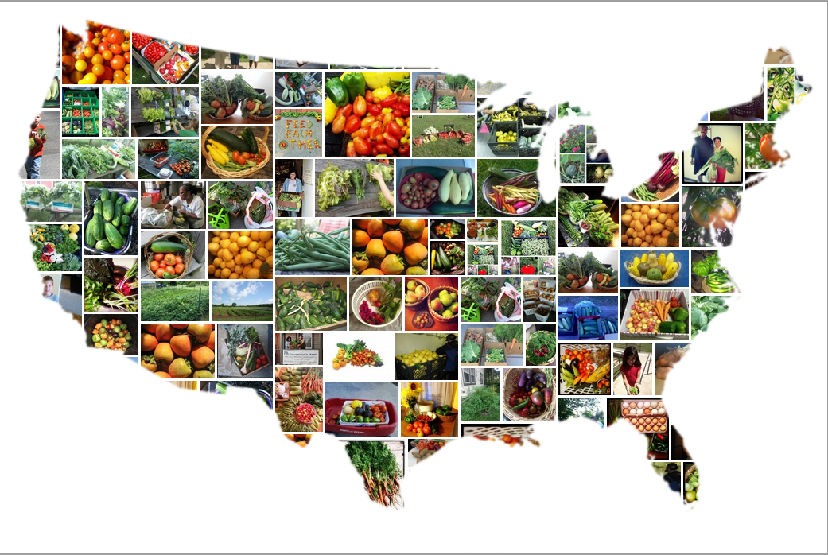
In the past, this would have been wasted food

