Slide 1
Hunger in America
50+ million food insecure Americans... Including 1 out of ever 4 kids under the age of 6
wasted food
charity from your backyard….
common sense
40 million home gardeners
food pantry
food bank
opportunity
charity
back yard
gardening
…not your back pocket
community garden
food insecurity

Slide 2

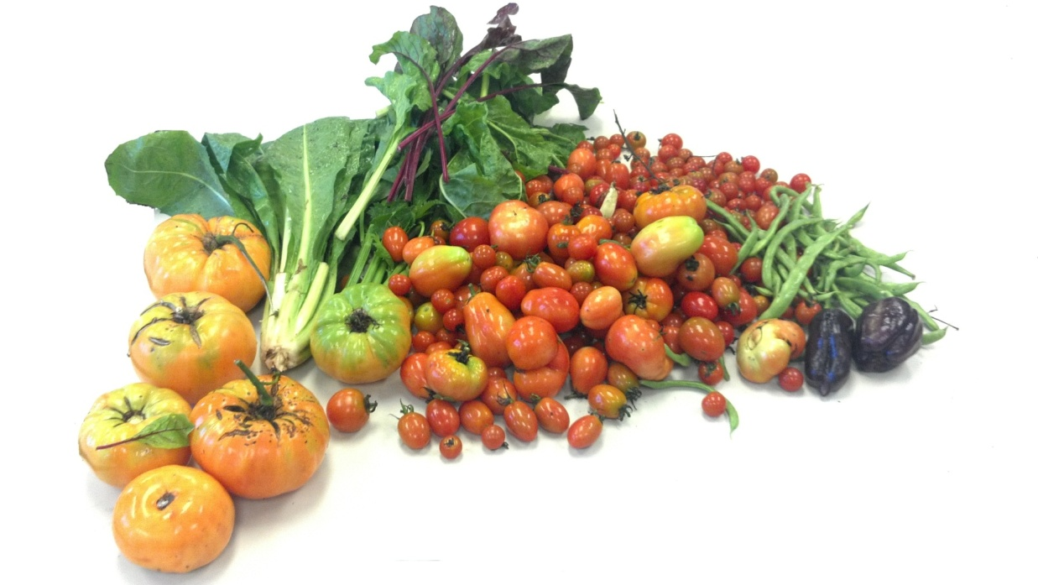
“No Food Left Behind”
A technology solution to food waste and hunger

Slide 3
“No Food Left Behind”
A technology solution to food waste and hunger
#AmpleHarvest
#GoogleTechTalk

Slide 4
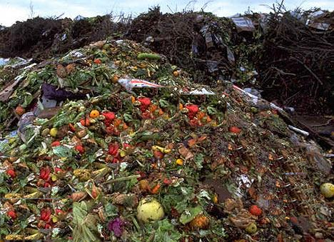
Food Waste
The
Impact
Food Safety Net
A Solution
The Future

Slide 5
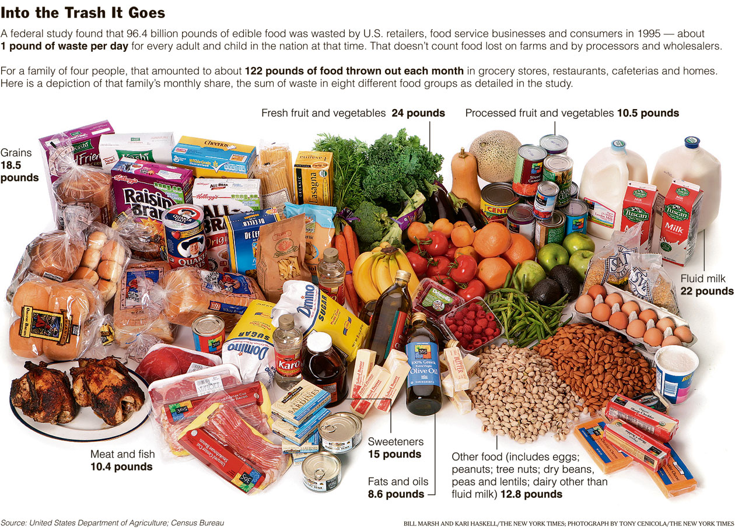
The Documented Problem
Food Waste

Slide 6
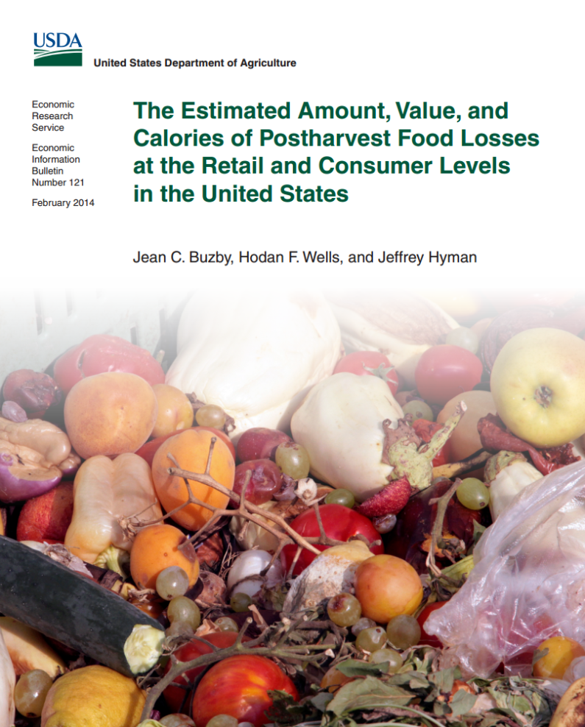
The Documented Problem
Food Waste:
31% of our food is wasted
Cost:
$161 billion in 2010
Impact:
1,249 calories per person daily

Slide 7
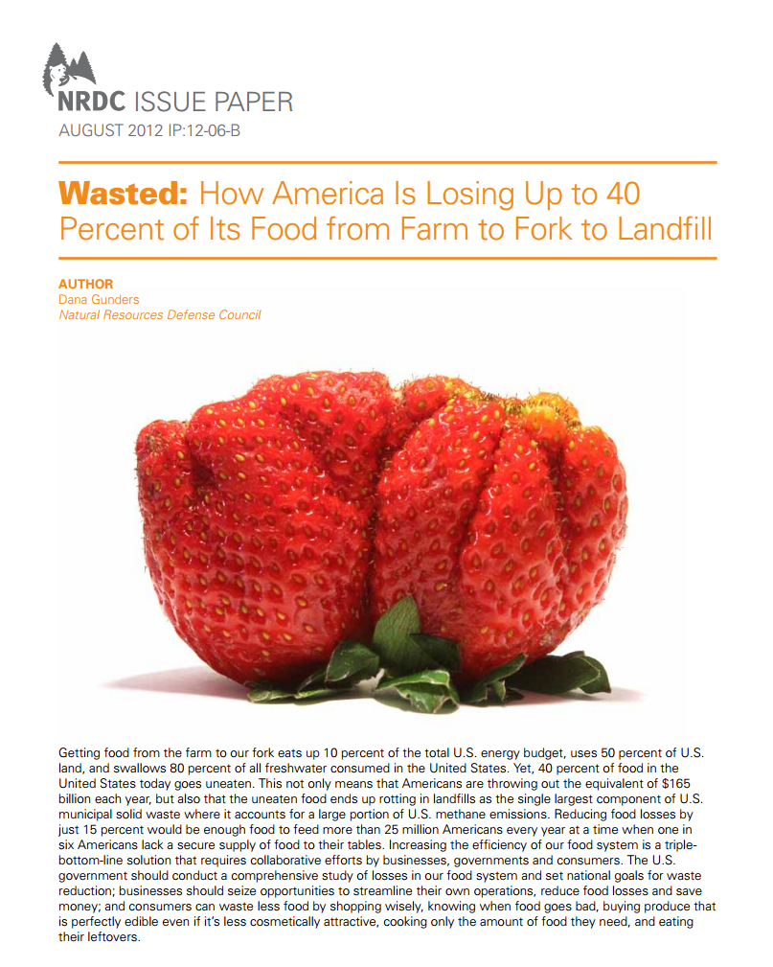
The Documented Problem
Food Waste:
40% loss (2012)
Cost:
4% of all our energy
32% of our fresh water usage
Impact:
20 lbs. per person monthly lost

Slide 8
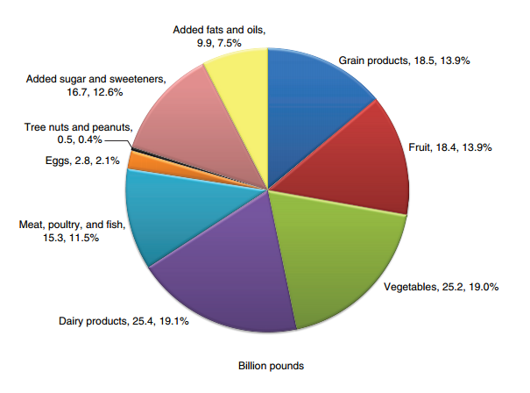
The Documented Problem

Slide 9
The Documented Problem
Documented Sources of Food Waste
Farms
  Not Fit for Market
  Not Priced for Market
  Not harvested
Storage
Processing
Transportation
Retail
  Damage
  Misuse of “Sell by Dates”
Consumer level
  Restaurant
  Home
  School
  Misuse of “Sell by Dates”

Slide 10
The Documented Problem
Documented Sources of Food Waste
Farms
  Not Fit for Market
  Not Priced for Market
  Not harvested
Storage
Processing
Transportation
Retail
  Damage
  Misuse of “Sell by Dates”
Consumer level
  Restaurant
  Home
  School
  Misuse of “Sell by Dates”
  Home / Community Gardens

Slide 11

The Problem No One Ever Noticed
America’s Home Gardeners
From Nat’l Gardening Association Reports of 2009 and 2014
35% of all households (42 million) grow food
17% increased in past 5 years
Average harvest: 300 lbs

Slide 12
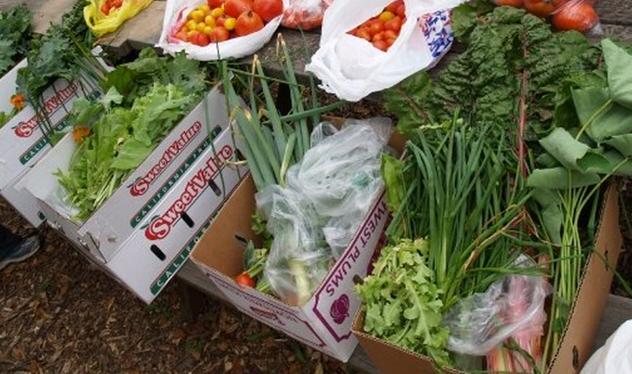
The Problem No One Ever Noticed
America’s Home Gardeners
9 million urban households grow food
200% increase in community gardening in 5 years
63% increase in growing food among millennials

Slide 13
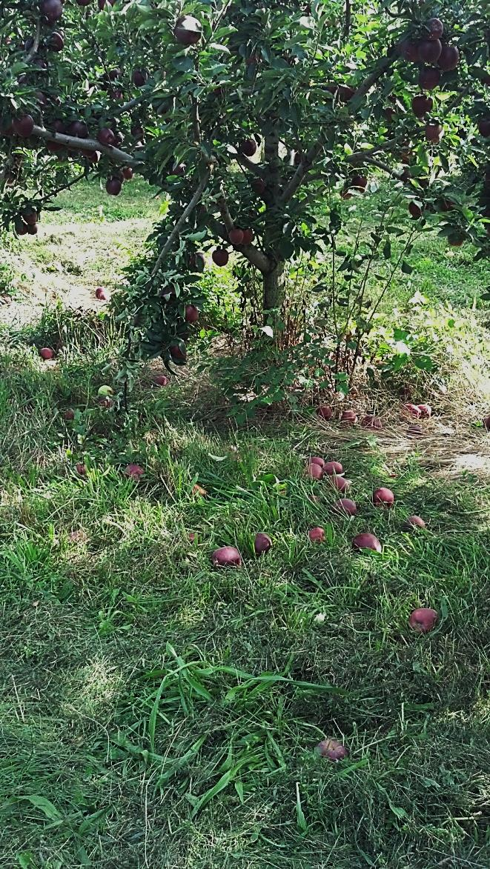
The Problem No One Ever Noticed
America’s Home Gardeners
Over planting/producing
Unable to share with friends
Not preserving/canning
Bored/overwhelmed

Slide 14
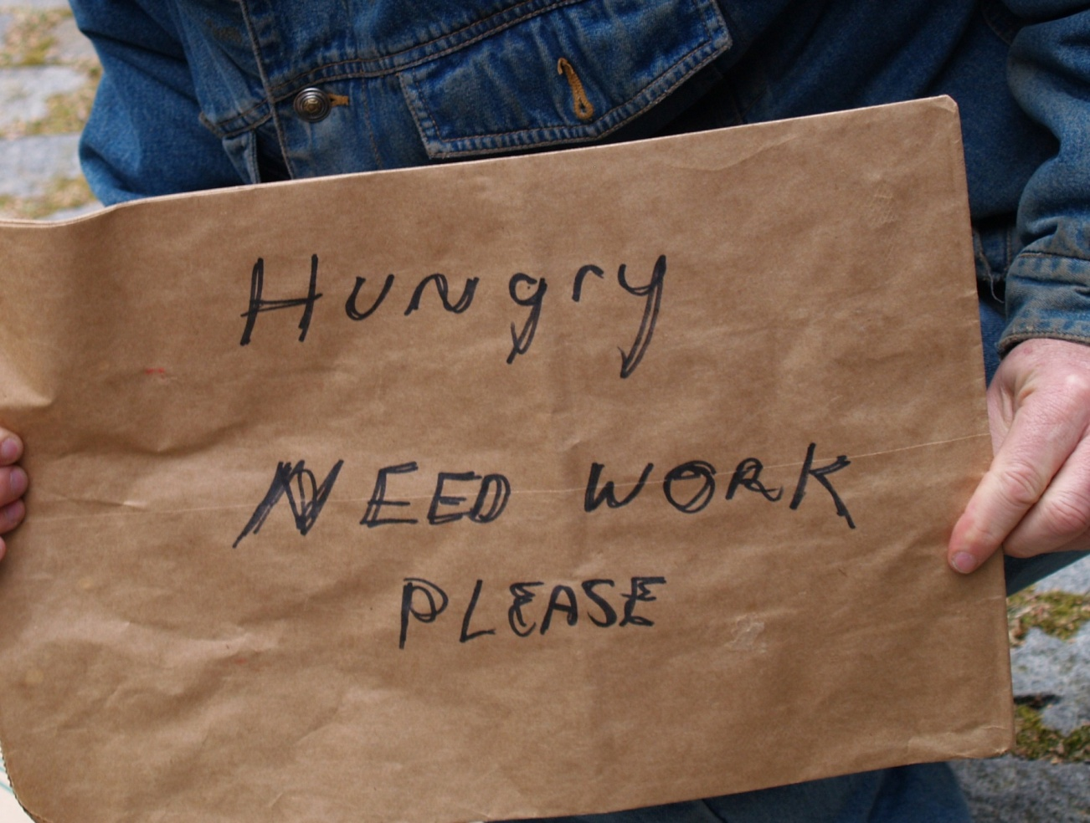
Food Waste
The
Impact
Food Safety Net
A Solution
The Future

Slide 15
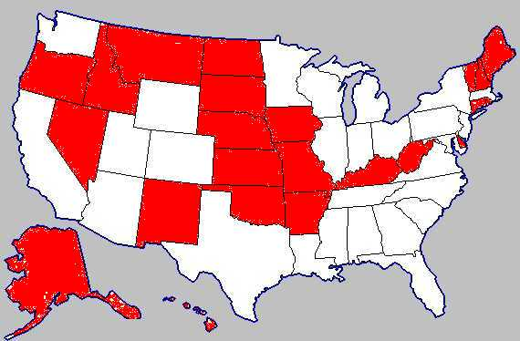
The Other America
1 out of every 6 Americans (50 million) are food insecure

Slide 16

The Other America
1 out of every 6 Americans (50 million) are food insecure
1 in 4 children under six lives in a food insecure home (1 in 3 if Hispanic)

Slide 17

The Other America
1 out of every 6 Americans (50 million) are food insecure
1 in 4 children under six lives in a food insecure home (1 in 3 if Hispanic)
Malnourished children do poorly in school and malnourished parents struggle in the work place.

Slide 18

The Other America
Health of America
Childhood Obesity
Type II Diabetes
Food related illnesses
Hypertension

Slide 19

The Other America
National Security Issue
75% of young people who apply for military service are not fit to serve.

Slide 20
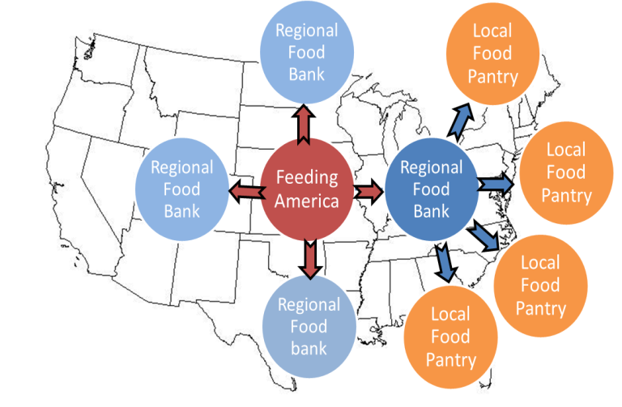
Food Waste
The
Impact
Food Safety Net
A Solution
The Future

Slide 21


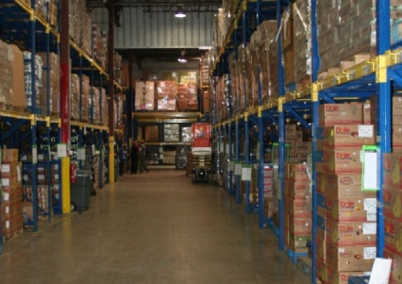


America’s Food Safety Net
50 M Hungry People
33.5K Pantries
203 Food Banks Nationwide
Time
Time
Notes:
Billions spent annually to fund food programs. Costs increase as food insecurity increases. Increases national health case costs.

Slide 22


America’s Food Safety Net
Chokepoint in our food system
50 M Hungry People
33.5K Pantries
203 Food Banks Nationwide
Time
X
Notes:
Billions spent annually to fund food programs. Costs increase as food insecurity increases. Increases national health case costs.

Slide 23
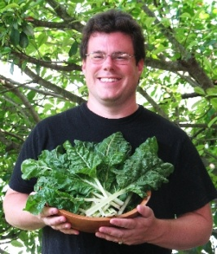

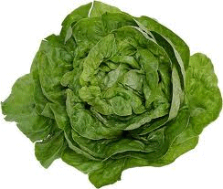


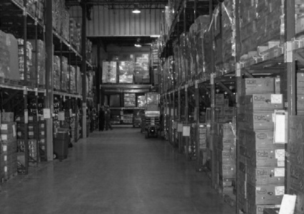

40M home growers
America’s Food Safety Net
The fresh food we lose every day
50 M Hungry People
33K Pantries
33.5K Pantries
203 Food Banks Nationwide
Time
Time
X
Notes:
Billions spent annually to fund food programs. Costs increase as food insecurity increases. Increases national health case costs.

Slide 24

Food Waste
The
Impact
Food Safety Net
A Solution
The Future

Slide 25
42M home growers
America’s Food Safety Net
USE TECHNOLOGY TO HELP EXCESS SUPPLY TO MEET DEMAND
50 M Hungry People
33K Pantries
203 Food Banks Nationwide
Time
X
Notes:
Billions spent annually to fund food programs. Costs increase as food insecurity increases. Increases national health case costs.

Slide 26


42M home growers
America’s Food Safety Net
What if we could
educate, encourage and
empower growers to
donate excess fresh food?
50 M Hungry People
33K Pantries
203 Food Banks Nationwide
Time
X
Notes:
Billions spent annually to fund food programs. Costs increase as food insecurity increases. Increases national health case costs.

Slide 27
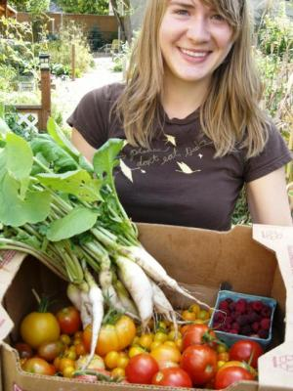
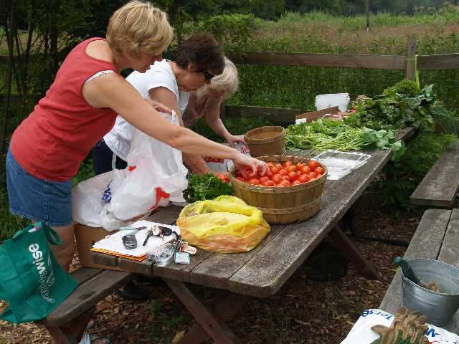
42M home growers
America’s Food Safety Net
Find A Nearby
Pantry
Register to be Searchable
50 M Hungry People
33K Pantries
203 Food Banks Nationwide
Time
X
Notes:
Billions spent annually to fund food programs. Costs increase as food insecurity increases. Increases national health case costs.

Slide 28
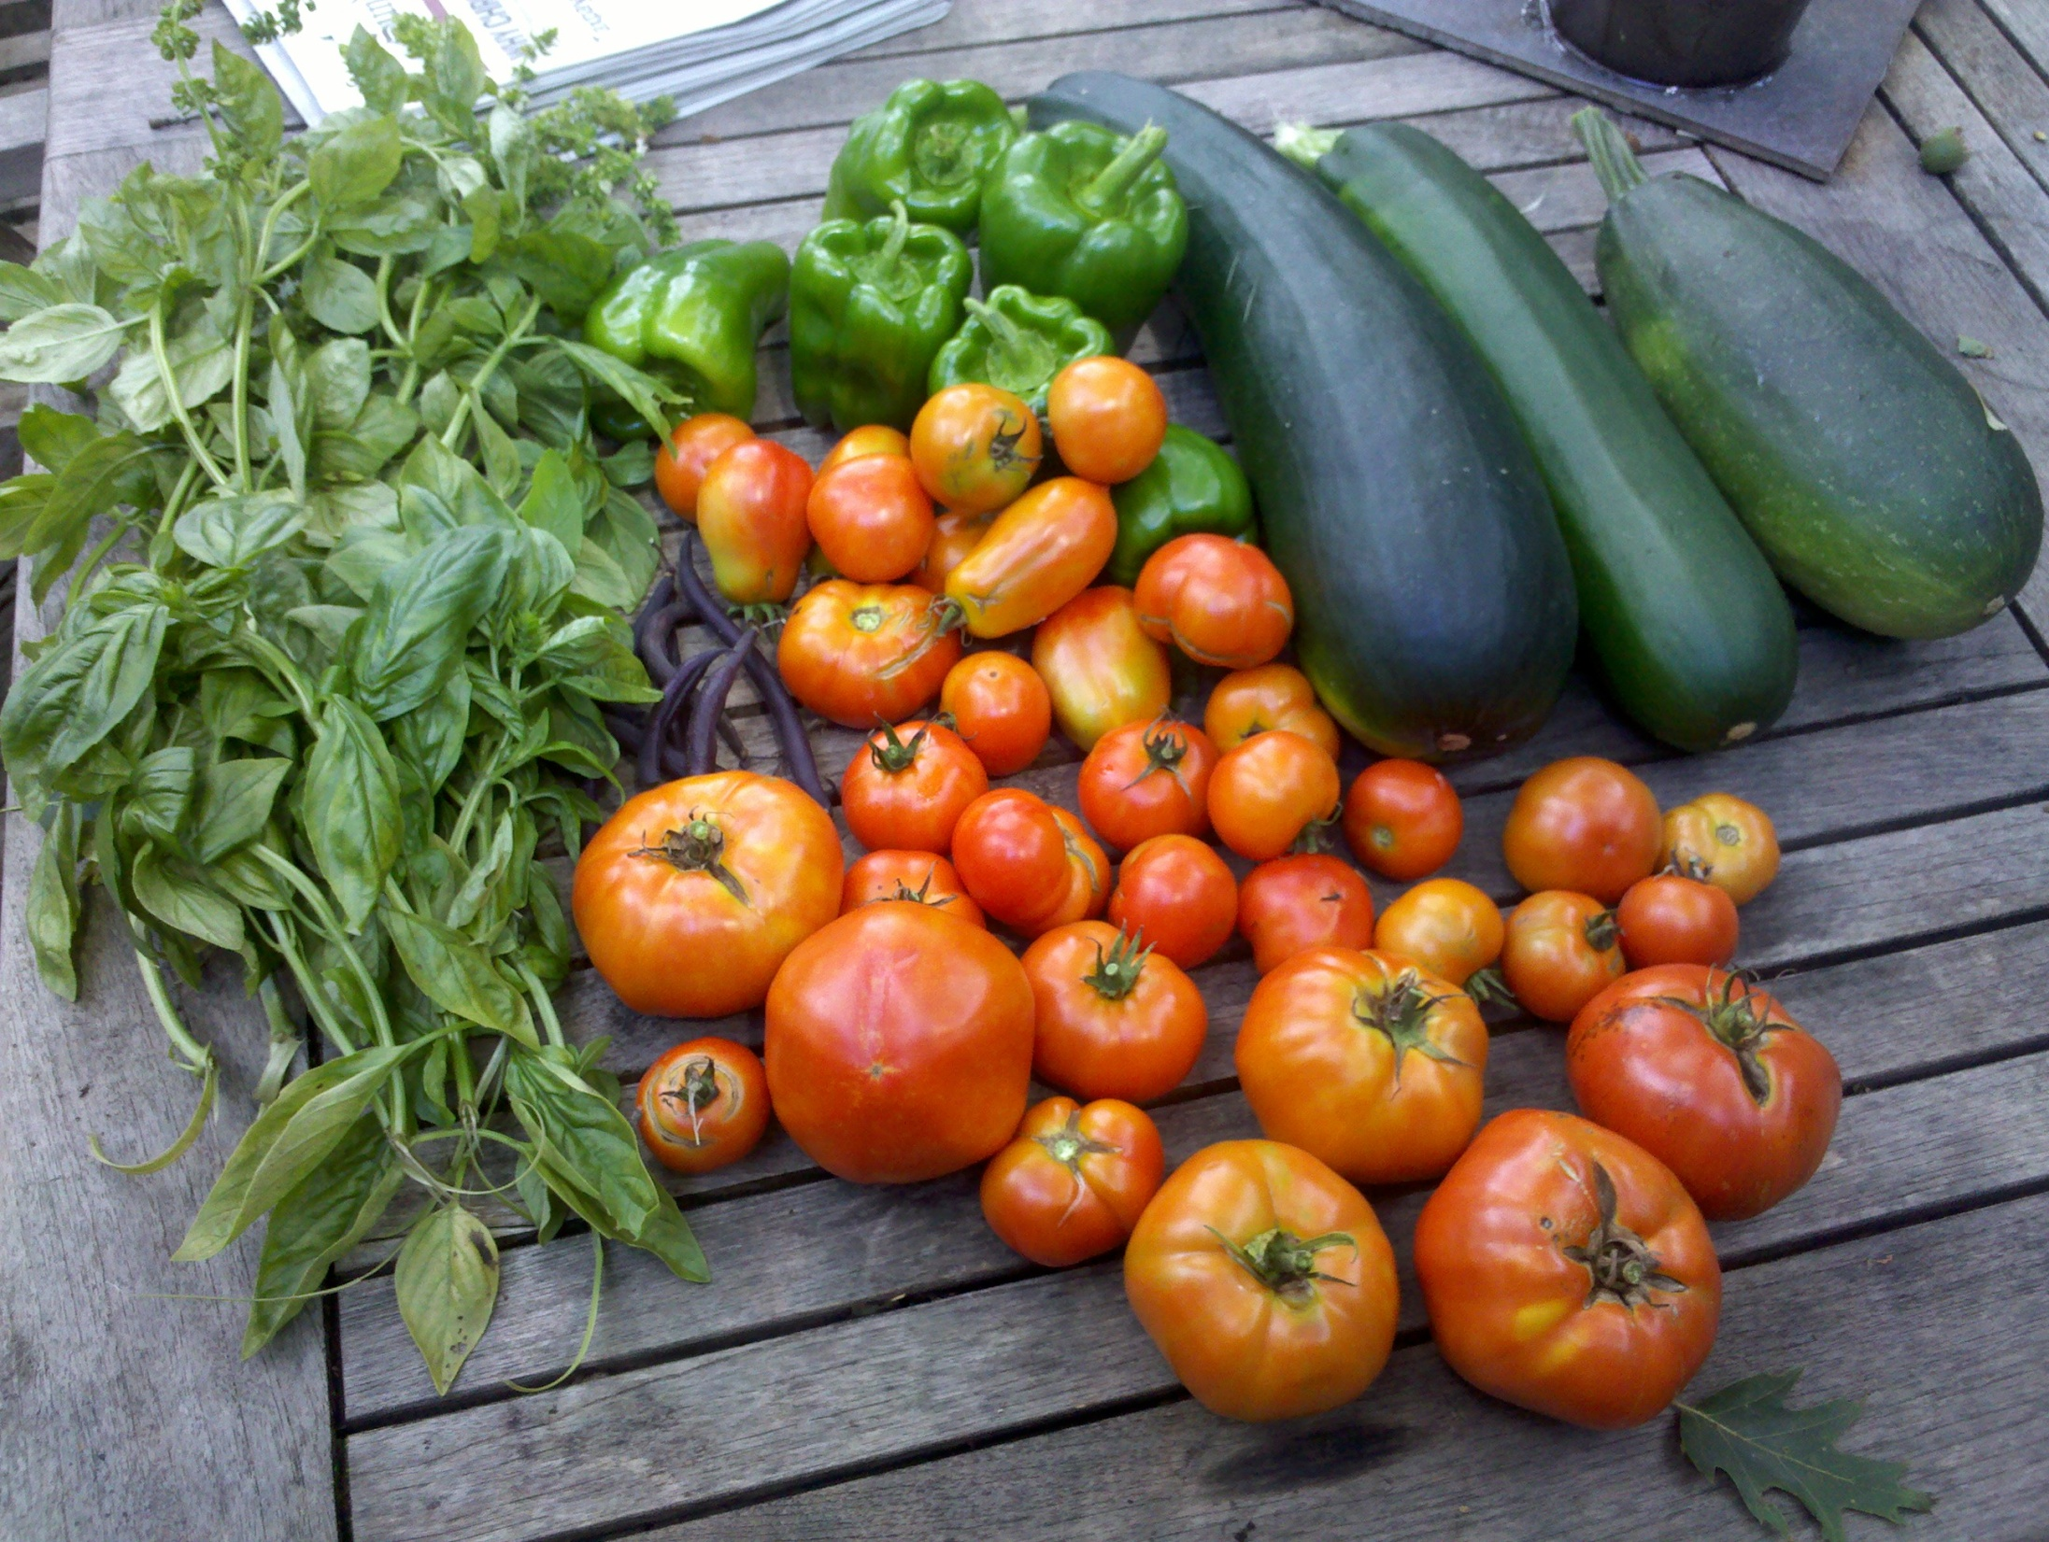
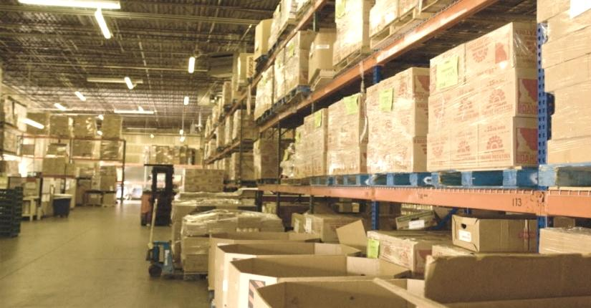
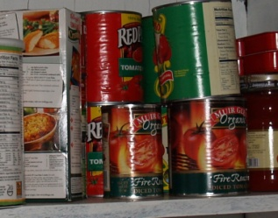
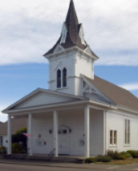


Food Drive
Food Bank
Food Pantries
X
....................................

Slide 29
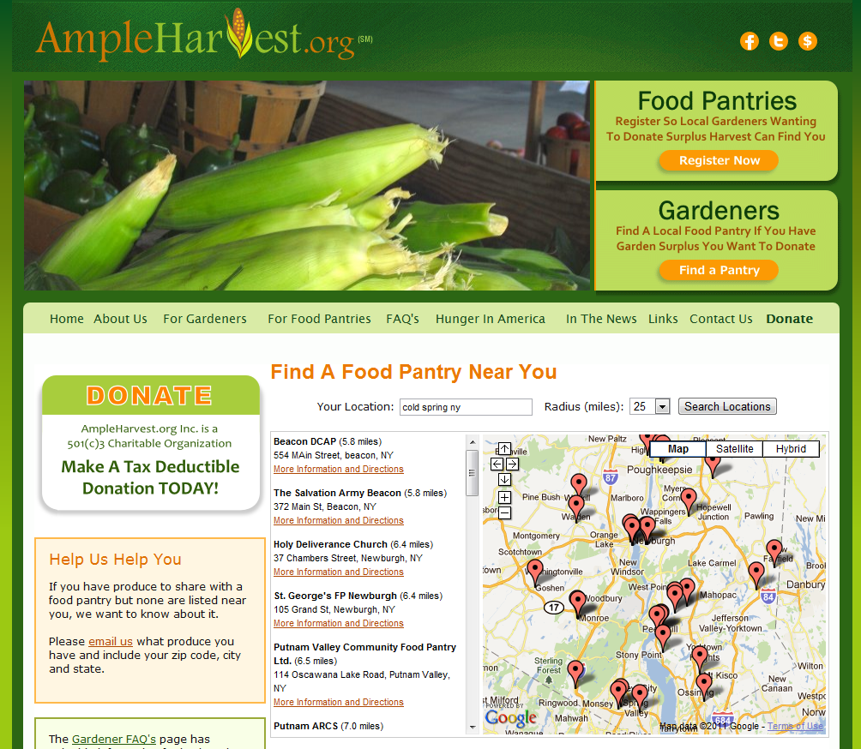
The
“Find A Pantry” page
Growers home location
How far the grower is willing to travel
Listing of pantries sorted by distance

Slide 30
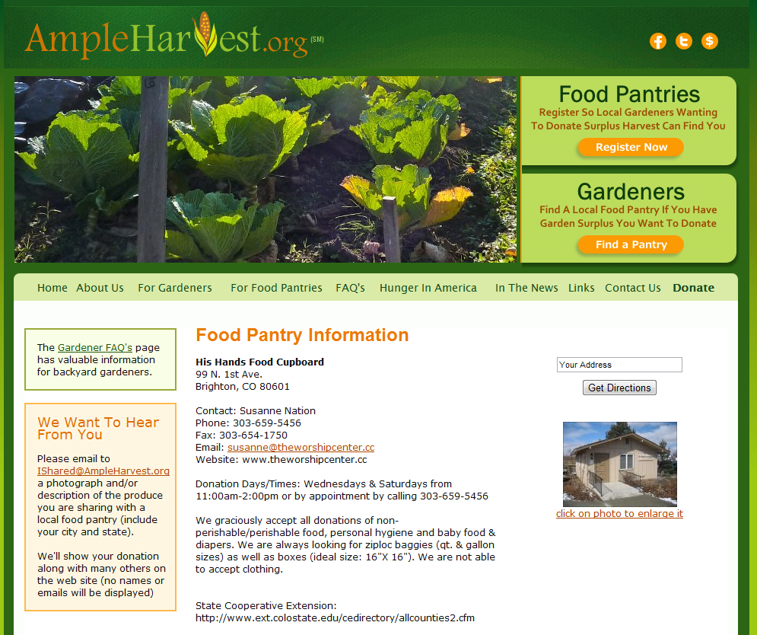
Example of a typical food pantry listing
Address
Driving directions from the gardener’s home to the pantry
Contact info
Donation times
Details on store bought items most needed
Helpful Master Gardner Info for gardeners

Slide 31
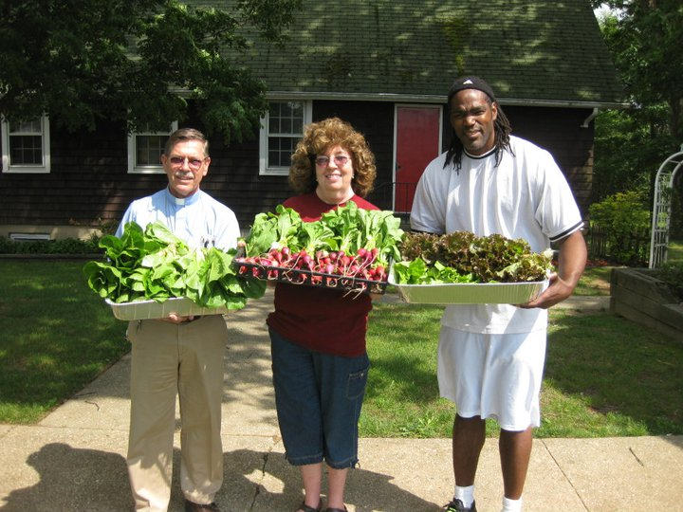
Key Innovations:
-No new infrastructure or transportation costs.
-Uses already existing resources: excess food, food pantries, technology and growers altruism.
--Feedback loop from pantries creates market efficiency for the first time.
-Growers behavioral change towards donating for the rest of their gardening life.
Notes:
40 million Americans grow food in home gardens average harvest is 300 lbs per growing season

Slide 32
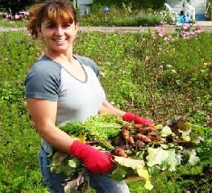
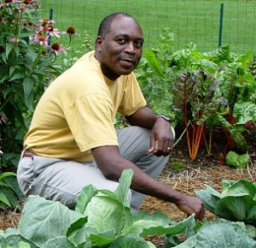
Key Innovations:
-Reduced waste stream, carbon footprint of pantry and lowered transportation environmental and fiscal costs of the food.
“Just in time” inventory logic built into AmpleHarvest.org assures availability of food hours after harvesting while eliminating refrigeration and storage issues.
Viral spread of opportunity by current donors to neighboring growers that the solution to hunger is in your back yard.
Reduced reliance on excess locally grown produce takes fiscal pressure off tax payers as well as the pantries themselves.
National healthcare costs reduced by increased availability of healthy food.
Millions able to contribute food to charity while cash strapped themselves.

Slide 33
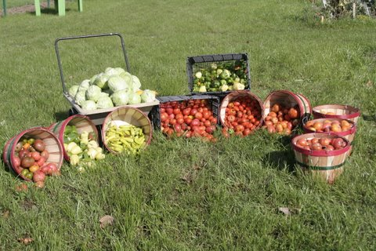
Food from a grower in urban Bridgeport Ct. donated to a food pantry.
Notes:
This is food that would have been wasted last year instead went to a food panty in Bridgeport ct.
Isnt this amazing? PAUSE and lookup
This idea works.. And is working in communities all across America... All 50 states.
And it’s only two years old.
We’re moving information instead of moving food to eliminate hunger and malnutrition nationwide.
This is a sustainable solution that costs absolutely nothing to implement and nothing to operate.
ITS AMERICANS ONLY NO COST HUNGER SOLUTION.
More importantly, we are exposing our our kids to fresh food apples not pre-sliced in cellophane
peas in pods not cans
You can help more Americans get access to healthy food.
Ask your local food pantry wants to start receiving freshly harvested locally grown food.
Remind them it is free, they need no refrigeration or storeage, and that it is free – you need to say that twice
Let all your gardening friends and their parents know about their opportuntiy to diminish hunger.
Tweet/blog/email and talk about it.
This is a viral effort... And we need viruses.

Slide 34
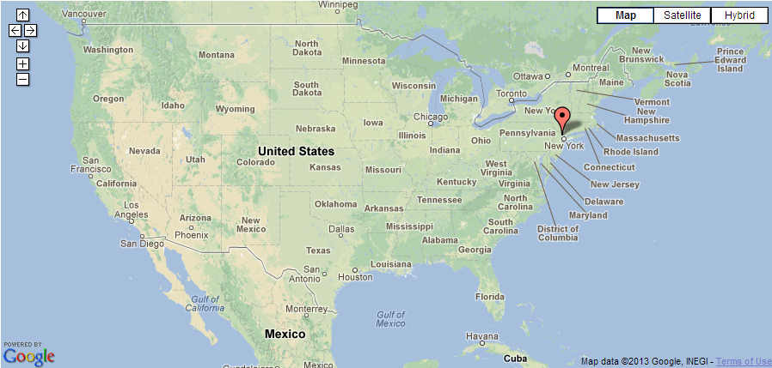
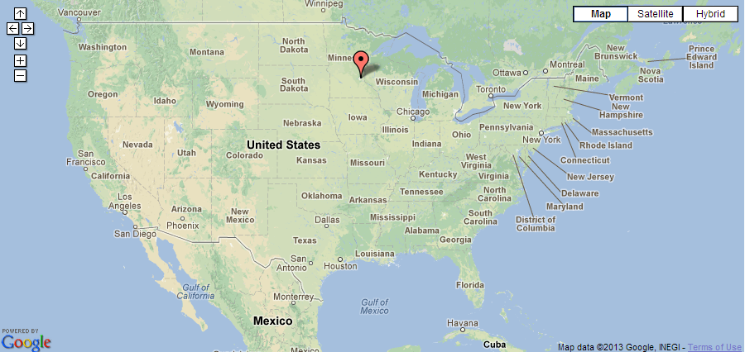
First Day of National Rollout
AmpleHarvest.org Impact Map May 20, 2009
1 Food Pantry – Pompton Plains NJ

Slide 35
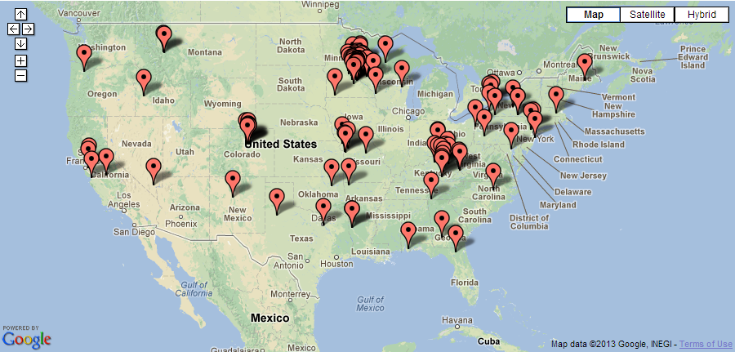
30 Days Later.....
AmpleHarvest.org Impact Map June 20, 2009
100 Food Pantries

Slide 36
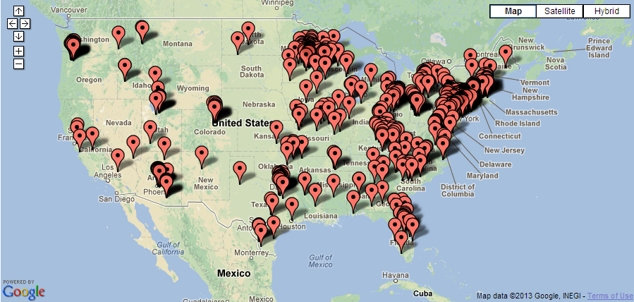
60 Days Later.....
AmpleHarvest.org Impact Map Aug 20, 2009
500 Food Pantries

Slide 37
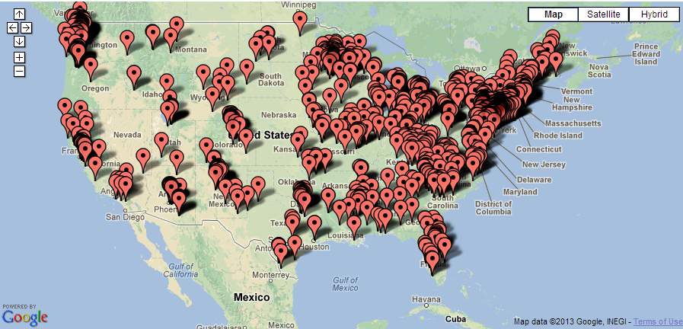
150 Days Later.....
AmpleHarvest.org Impact Map Oct 15, 2009
1,000 Food Pantries

Slide 38
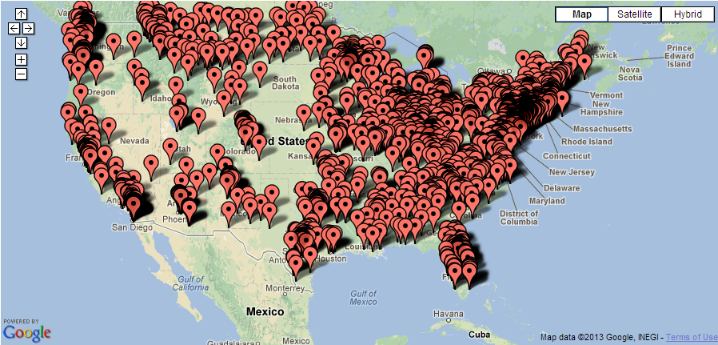
One Year Later.....
AmpleHarvest.org Impact Map May 30, 2010
2,000 Food Pantries

Slide 39
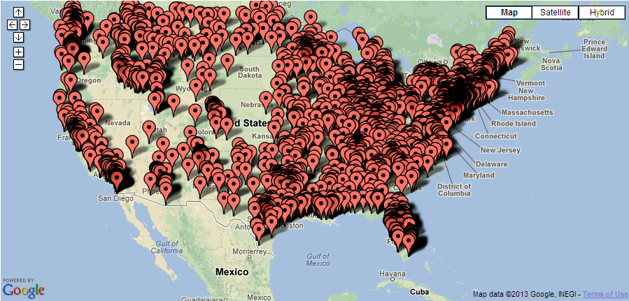
AmpleHarvest.org Impact Map Dec 8, 2010
3,000 Food Pantries

Slide 40

AmpleHarvest.org Impact Map Jul 17, 2011
4,000 Food Pantries

Slide 41
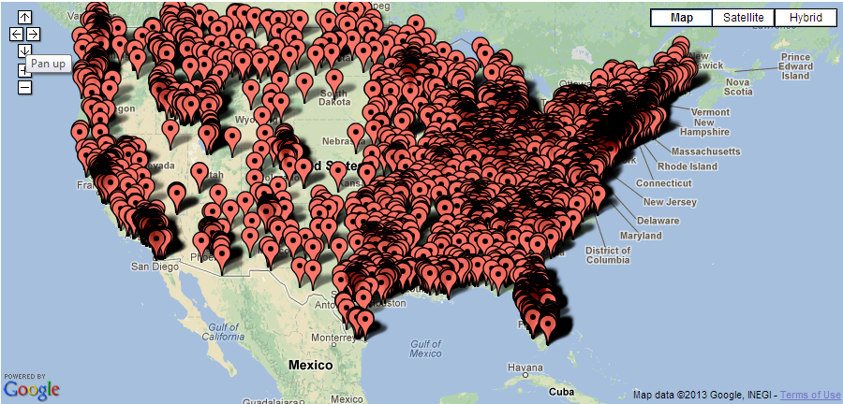
AmpleHarvest.org Impact Map Apr 1 2012
5,000 Food Pantries

Slide 42
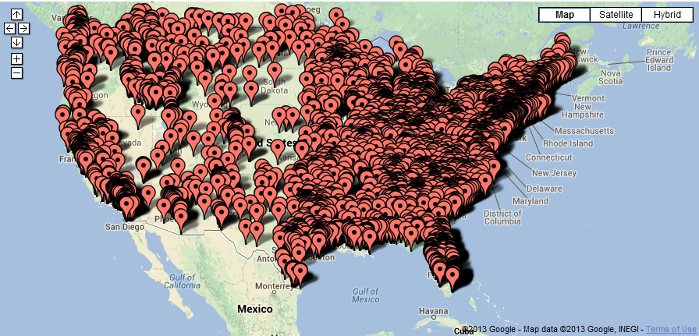
:
Now helping 1 in 5 pantries nationwide get locally grown fresh food – for free.
AmpleHarvest.org Impact Map Today
Nearly 7,000 Food Pantries

Slide 43
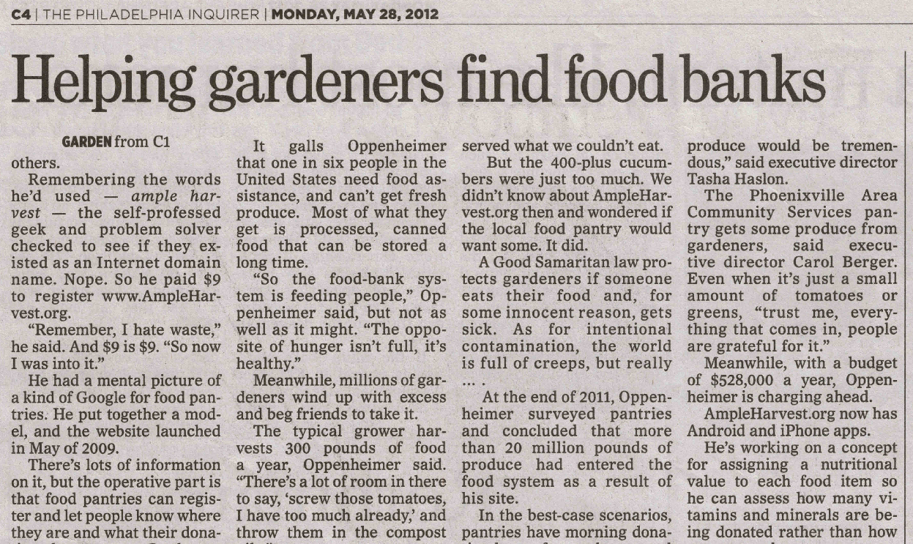



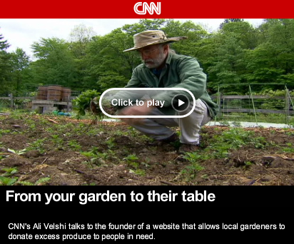








WHY ALL THE EXCITEMENT?

Slide 44
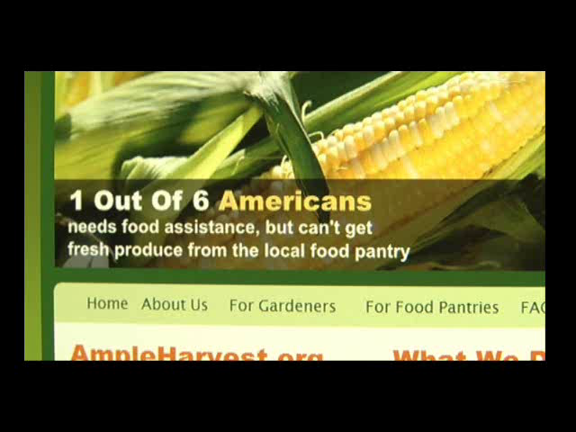
Typical TV News Story.
WHY ALL THE EXCITEMENT?
Notes:
Jamie Oliver – TED speaker
First Lady Michelle Obama – Lets Move
Michael Pollan – Author
For the millions of Americans who can’t afford healthier eating, ampleharvest.org is enabling what they advocate

Slide 46
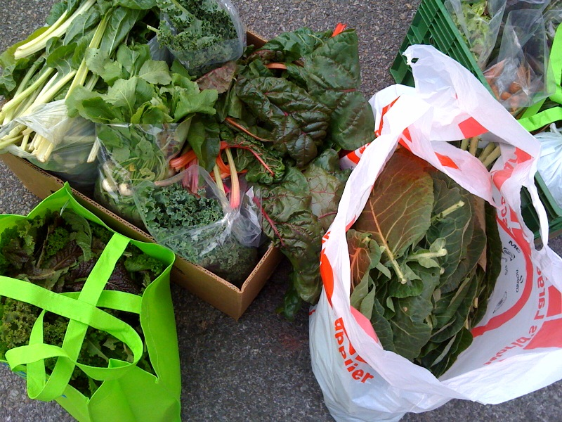
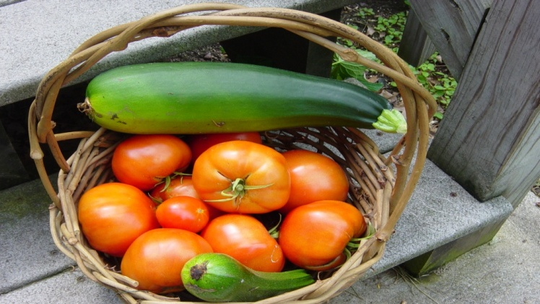
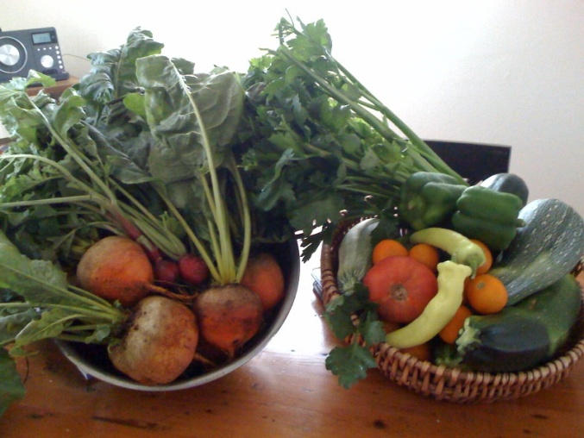
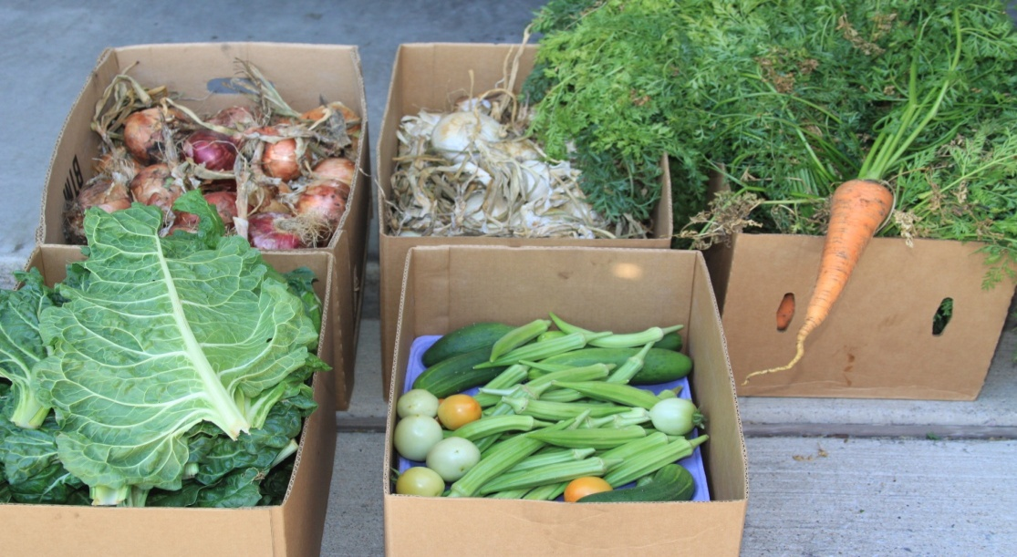
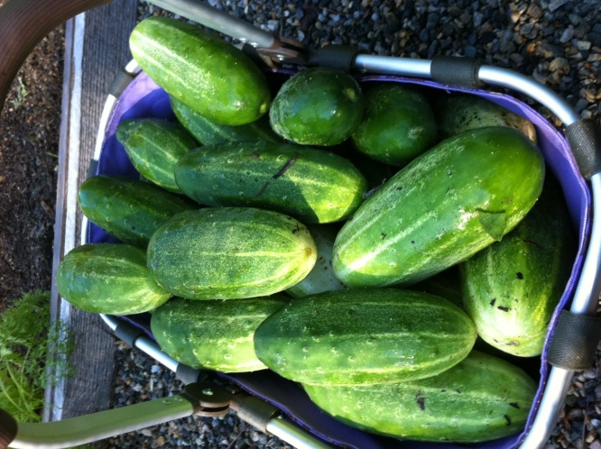

Slide 47
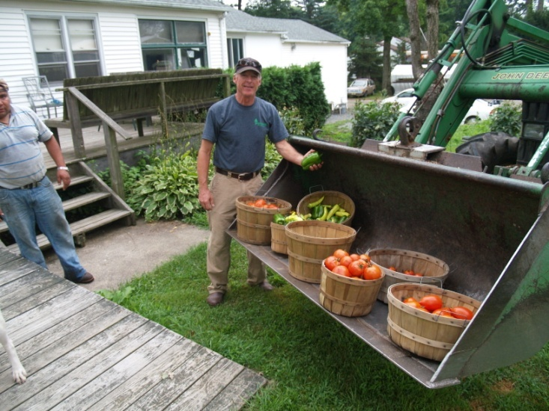

Slide 48
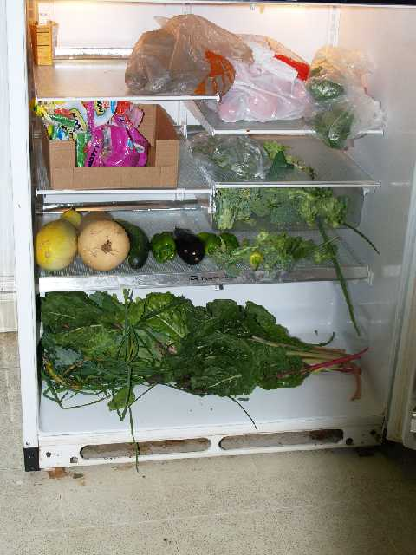
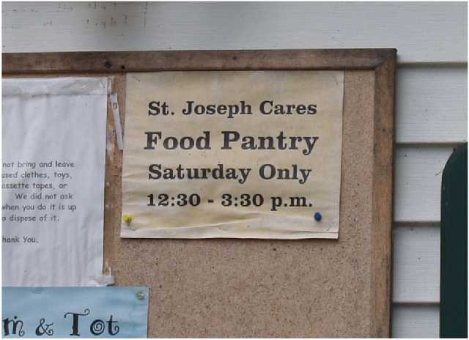




Slide 49

Food Waste
The
Impact
Food Safety Net
A Solution
The Future

Slide 50
We’ve Just Started.....
Planned Programs
Relaunch with new site and technology
  Time availability management
  Push technology
  Google knowledge graphs
  Resource balancing
GleaningHarvest.org
Community Nutritional Index
ProducePedia

Slide 51

First Look!

Slide 52


First Look!
AmpleHarvest.org now included in Feds Feed Families thanks to help from Let’s Move! and Rep.Pingree

Slide 53

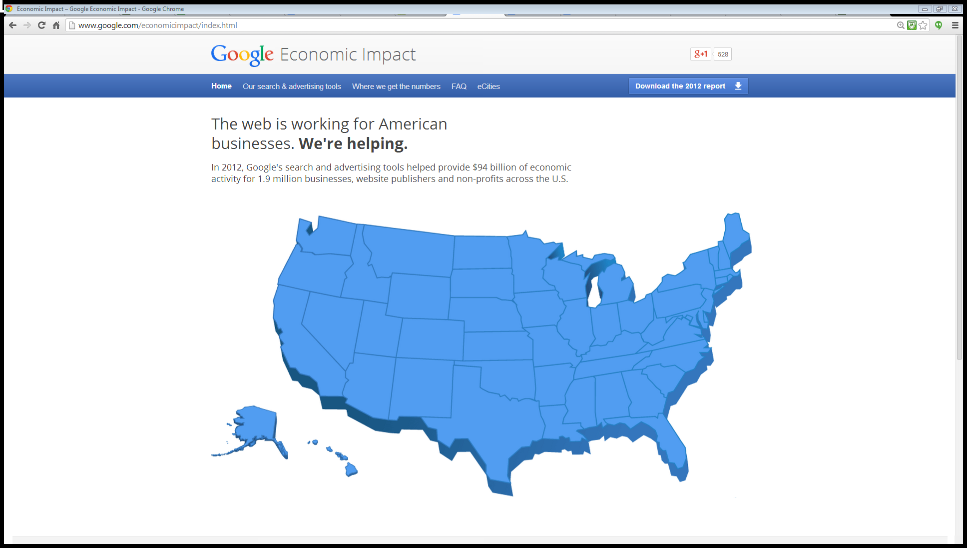
First Look!

Slide 54

First Look!

Slide 55
What Makes AmpleHarvest.org’s Model So Extraordinary?
Simple
“Makes Sense”
Uses existing resources
Viral spread

Slide 56
What Makes AmpleHarvest.org’s Model So Extraordinary?
Simple
“Makes Sense”
Uses existing resources
Viral spread
Efficient
No Logistics
No Warehousing
Moves Information – Not Food

Slide 57
What Makes AmpleHarvest.org’s Model So Extraordinary?
Simple
“Makes Sense”
Uses existing resources
Viral spread
Efficient
No Logistics
No Warehousing
Moves Information – Not Food
Universal
Works in any community
Works with home growers & farms
Builds community bridges

Slide 58
What Makes AmpleHarvest.org’s Model So Extraordinary?
Simple
“Makes Sense”
Uses existing resources
Viral spread
Efficient
No Logistics
No Warehousing
Moves Information – Not Food
Universal
Works in any community
Works with home growers & farms
Builds community bridges
Meets Pressing Needs
Childhood Obesity
Type II Diabetes
Environment

Slide 59
What Makes AmpleHarvest.org’s Model So Extraordinary?
The Other Good Stuff
Costs a fraction of any other national program
Sustainable
Relies on inherent good will
Food donations are tax deductible
Supported by all faith communities
Essentially cost free to the community
Well positioned to solve a problem and “go home”
“Feels right.”

Slide 60


















Notes:
These government, corporate and non-profit partners are working with us collaboratively towards helping to get more fresh food into the pantries.
This, is the missling link in what was, a broken chain.

Slide 61
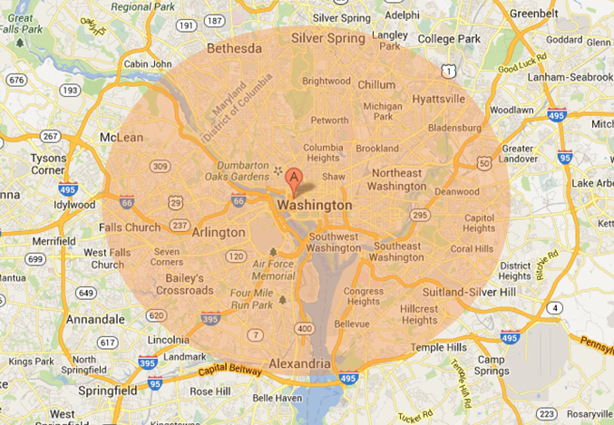
“No Good and Innovative Deed Goes Unpunished”
Metrics Conundrum
“How many pounds of food?”
“How many meals?”

Slide 62
“No Innovative Deed Goes Unpunished”
Metrics Conundrum
“How many pounds of food?”
“How many meals?”
“How much opportunity to end food waste?”
“How much nutrition gets to the community?”

Slide 63
“No Innovative Deed Goes Unpunished”
Innovation Funding Conundrum
Traditional Food
Program
Operations: $10K
Processed Food: $90K
----------------
Net Cost: $100K
Appears to be
10% overhead
Staffing & Operations
$10K
Families fed one time
$100K
Donation
Buy & Distribute Processed Food $90K
Ask for more money annually
Operations: $10K
Fresh Food: $0
--------------------
Net Cost: $10K
Appears to be:
100% overhead
Staffing & Technology
$10K
Local Growers Feeding Families Going Forward
$10K
Donation
Problem Solved
For Good!

Slide 64

WORK WITH US
AS WE
NOURISH AMERICA
Notes:
Jamie Oliver – TED speaker
First Lady Michelle Obama – Lets Move
Michael Pollan – Author
For the millions of Americans who can’t afford healthier eating, ampleharvest.org is enabling what they advocate

Slide 65
Join Us! Googlers Making The Difference Help End Hunger. For Good!
What you can do | How to do it
Share with friends nationwide | www.AmpleHarvest.org/local
Google matches contributions to $6K | www.AmpleHarvest.org/google
Help spread awareness | www.AmpleHarvest.org/speaker
Get Involved | gary@AmpleHarvest.org
Notes:
Jamie Oliver – TED speaker
First Lady Michelle Obama – Lets Move
Michael Pollan – Author
For the millions of Americans who can’t afford healthier eating, ampleharvest.org is enabling what they advocate

Slide 66
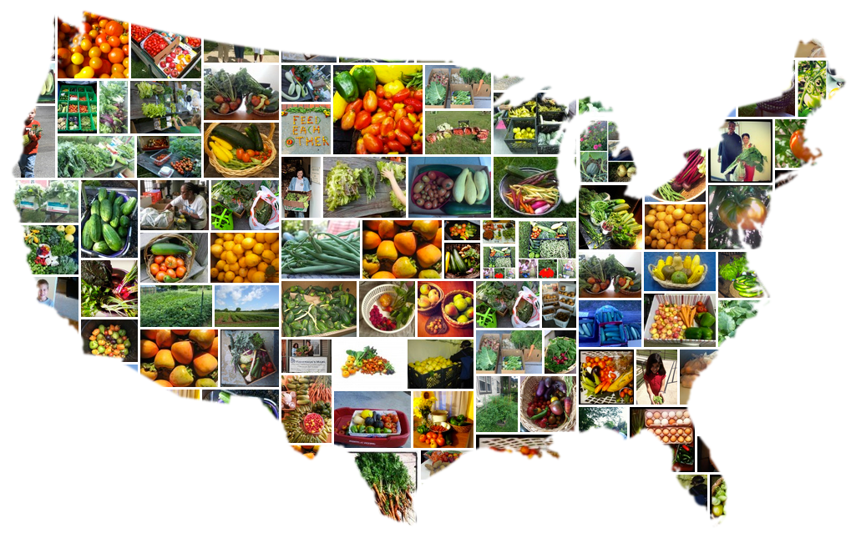
All It Takes Is An Ample Harvest, And A Heart
Notes:
Jamie Oliver – TED speaker
First Lady Michelle Obama – Lets Move
Michael Pollan – Author
For the millions of Americans who can’t afford healthier eating, ampleharvest.org is enabling what they advocate

