Slide 1

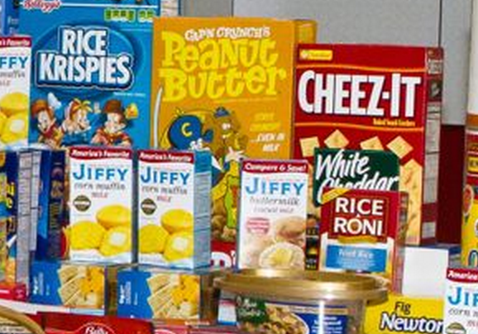
The Problem:
Chokepoints
Hunger Chokepoints
What if connections between fresh food and hungry people were blocked?

Slide 2
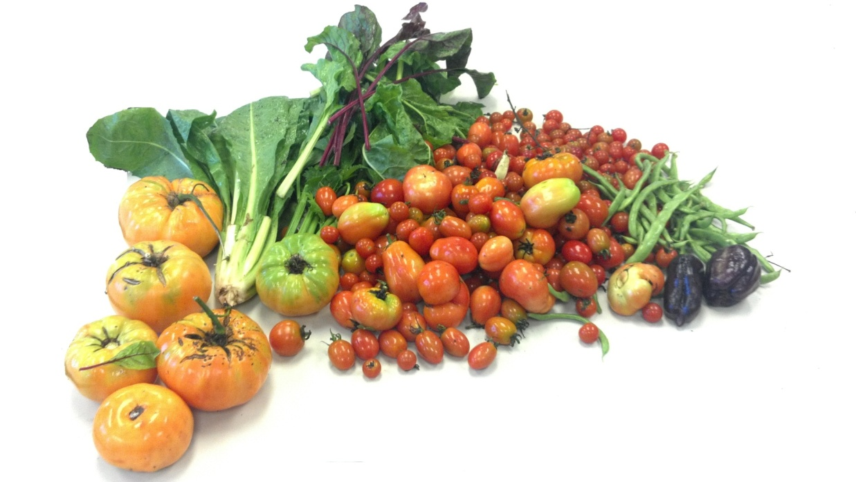

The Problem:
Chokepoints
Hunger Chokepoints
What if connections between fresh food and hungry people were blocked?

Slide 3





The Problem:
Chokepoints
Chokepoint in our food system
50 M Hungry People
33.5K Pantries
203 Food Banks Nationwide
Time
Notes:
Billions spent annually to fund food programs. Costs increase as food insecurity increases. Increases national health case costs.

Slide 4
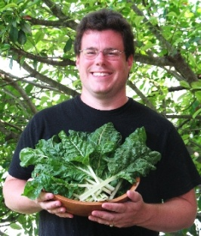


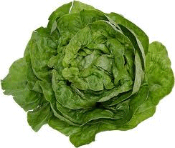
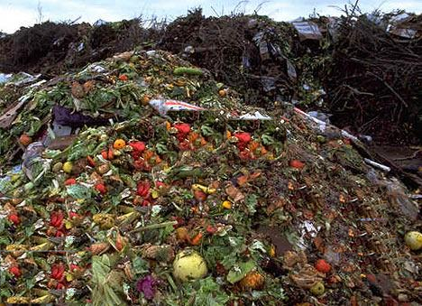


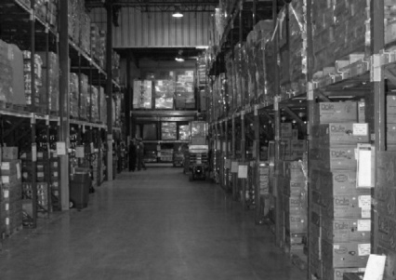

40M home growers
The Problem:
Chokepoints
The fresh food we lose every day
50 M Hungry People
33K Pantries
33.5K Pantries
203 Food Banks Nationwide
Time
Time
X
Notes:
Billions spent annually to fund food programs. Costs increase as food insecurity increases. Increases national health case costs.

Slide 5

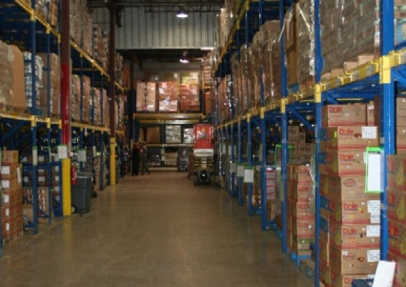


40M home growers
An Innovation:
Move Information–Not Food
What if we could
educate, encourage and
empower growers to
donate excess fresh food?
50 M Hungry People
33K Pantries
203 Food Banks Nationwide
Time
X
Notes:
Billions spent annually to fund food programs. Costs increase as food insecurity increases. Increases national health case costs.

Slide 6

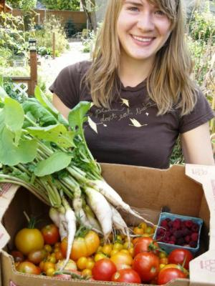
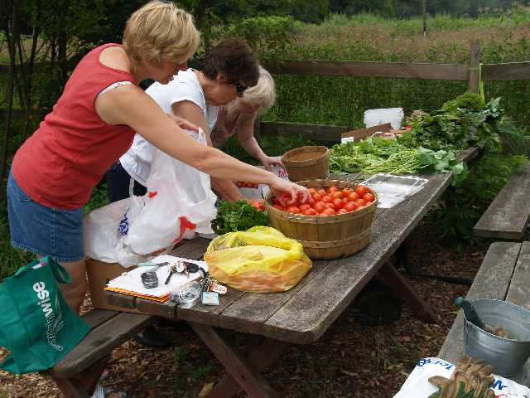
40M home growers
An Innovation:
Move Information–Not Food
Find A Nearby
Pantry
Register to be Searchable
50 M Hungry People
33K Pantries
203 Food Banks Nationwide
Time
X
Notes:
Billions spent annually to fund food programs. Costs increase as food insecurity increases. Increases national health case costs.

Slide 7
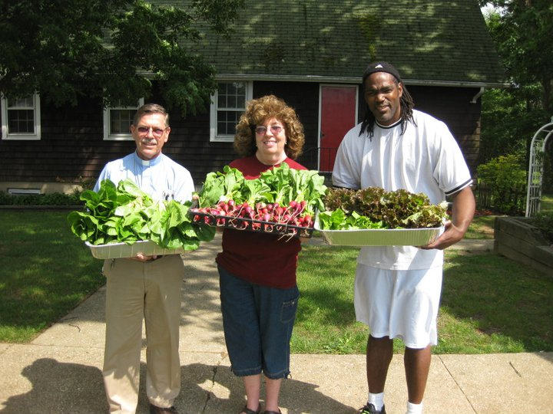
An Innovation:
Impact
Key Innovations:
-No new infrastructure or transportation costs.
-Uses already existing resources: excess food, food pantries, technology and growers altruism.
--Feedback loop from pantries creates market efficiency for the first time.
-Growers behavioral change towards donating for the rest of their gardening life.
Notes:
40 million Americans grow food in home gardens average harvest is 300 lbs per growing season

Slide 8
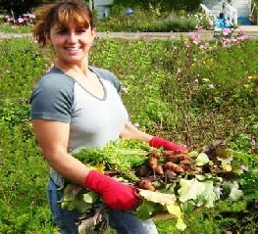
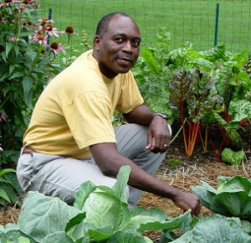
An Innovation:
Impact
Key Innovations:
-Reduced waste stream, carbon footprint of pantry and lowered transportation environmental and fiscal costs of the food.
“Just in time” inventory logic built into AmpleHarvest.org assures availability of food hours after harvesting while eliminating refrigeration and storage issues.
Viral spread of opportunity by current donors to neighboring growers that the solution to hunger is in your back yard.
Reduced reliance on excess locally grown produce takes fiscal pressure off tax payers as well as the pantries themselves.
National healthcare costs reduced by increased availability of healthy food.
Millions able to contribute food to charity while cash strapped themselves.

Slide 9
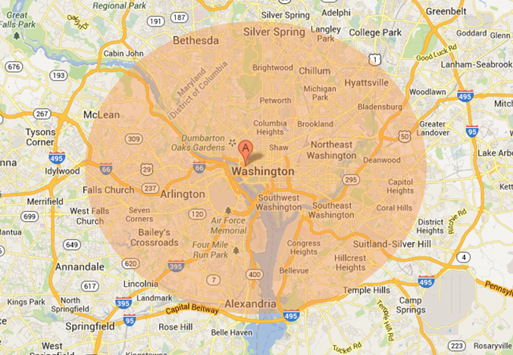
An Innovation:
Impact
How many growers live within 250 sq. mile area?

Slide 10
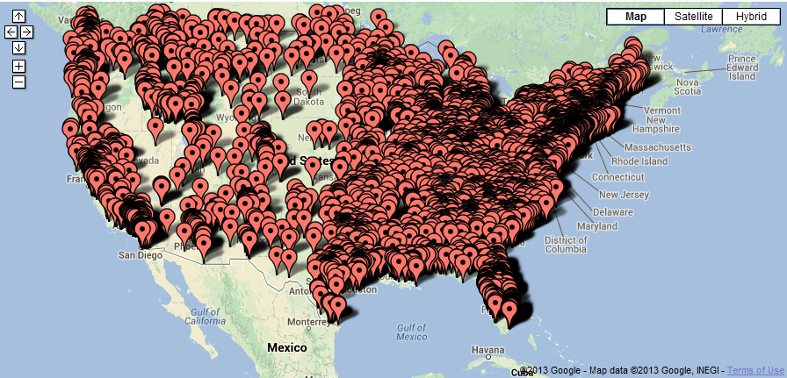
An Innovation:
Impact
:
Now helping 1 in 5 pantries nationwide get locally grown fresh food – for free.
AmpleHarvest.org Impact Map Today
6,700 Food Pantries

Slide 11
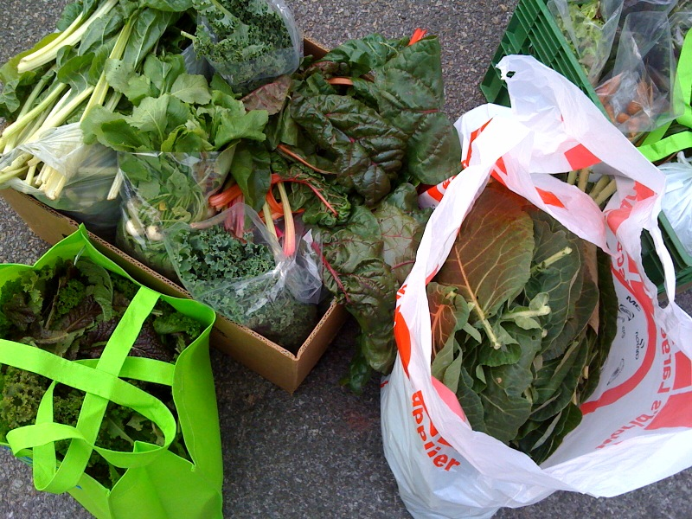
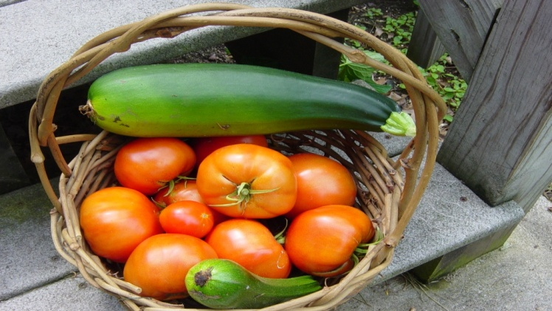
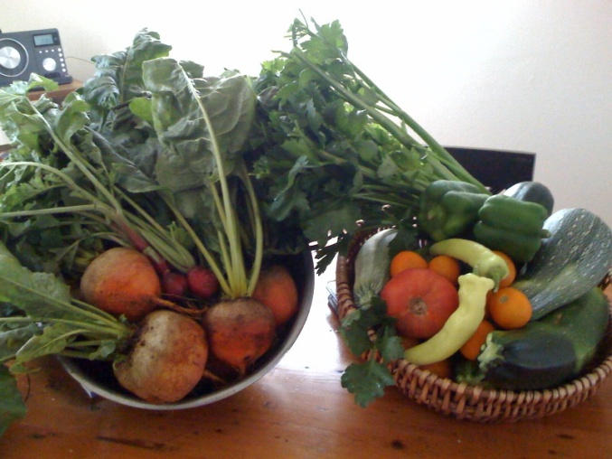
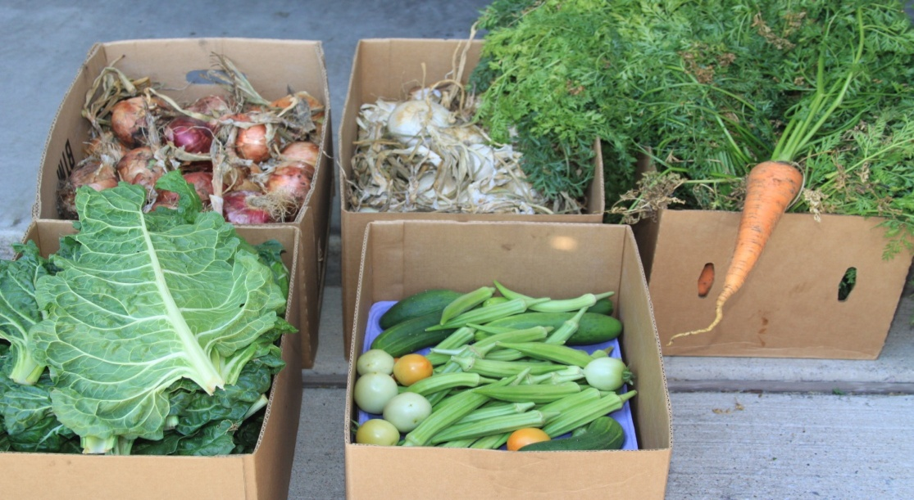
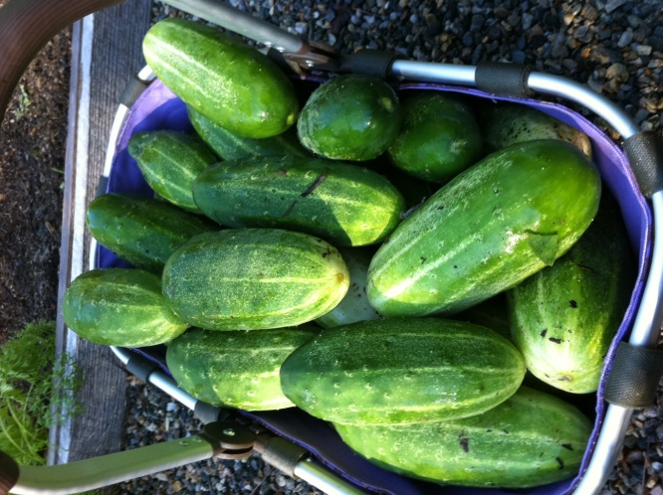
An Innovation:
The Future:
Gardeners Donating Food

Slide 12
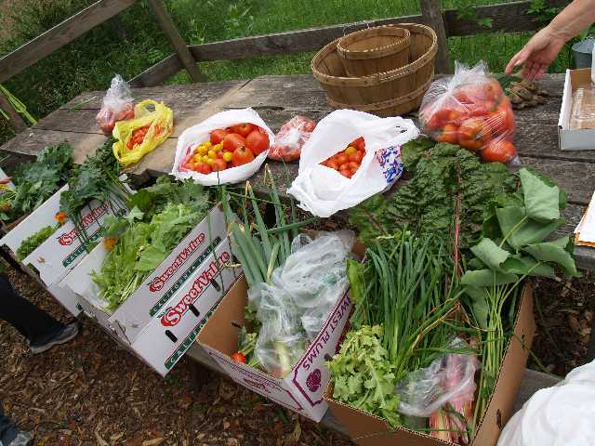
An Innovation:
The Future:
Community Gardens donating food

Slide 13
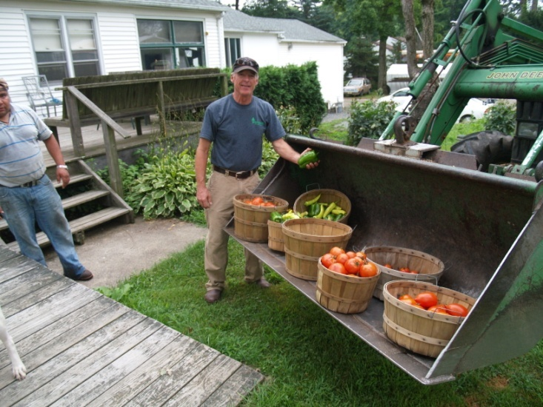
An Innovation:
The Future:
Farmers donating food

Slide 14
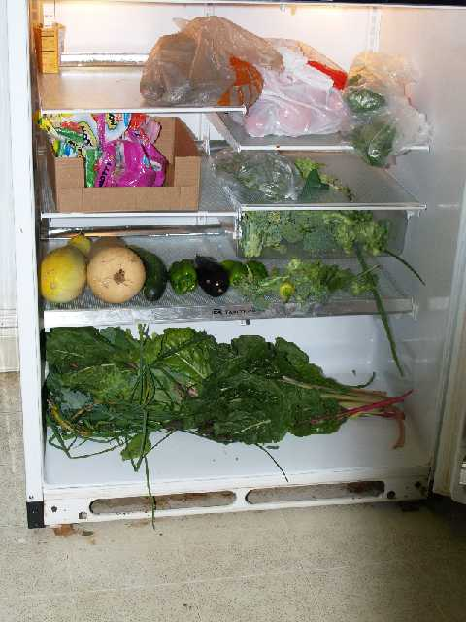
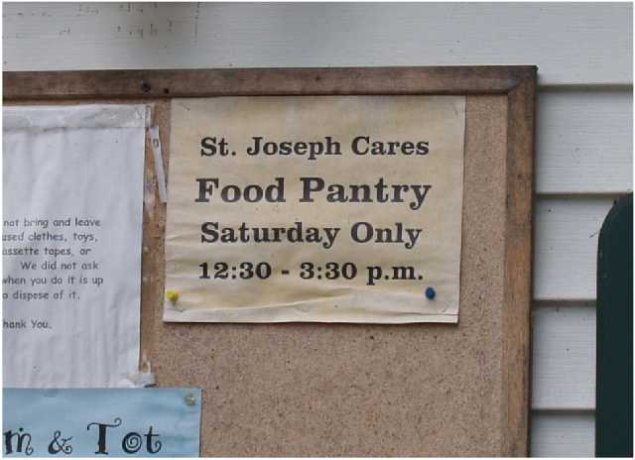



An Innovation:
The Future:
Pantries receiving food

Slide 15
An Innovation:
The Future
What Makes AmpleHarvest.org’s Model So Extraordinary?
Simple
“Makes Sense”
Uses existing resources
Works in legacy environment
Viral spread
Efficient
No Food Purchased
No Logistics
No Warehousing
Moves Information – Not Food
Universal
Works in any community
Works with home growers & farms
Builds community bridges
Open Sourced
Meets Pressing Needs
Hunger/Nutrition
Childhood Obesity
Type II Diabetes
Environment

Slide 16
An Innovation:
The Future
What Makes AmpleHarvest.org’s Model So Extraordinary?
The Other Good Stuff
Works on a budget that’s a fraction of any other national program
Sustainable
Take advantage of inherent good will
Offer donors without cash the opportunity to give charity
Food donations are tax deductible
Food donations covered by federal Good Samaritan law
Supported by all faith communities
Essentially cost free to the community
Well positioned to solve a problem and “go home”
“Feels right.”

Slide 17
An Innovation:
Join Us
We Need Your Help
Corporate Support
Cause Marketing
Foundation Introductions
Match Employee Contributions
Speaking Opportunities
Virtual Food Drives
Notes:
Jamie Oliver – TED speaker
First Lady Michelle Obama – Lets Move
Michael Pollan – Author
For the millions of Americans who can’t afford healthier eating, ampleharvest.org is enabling what they advocate

Slide 18
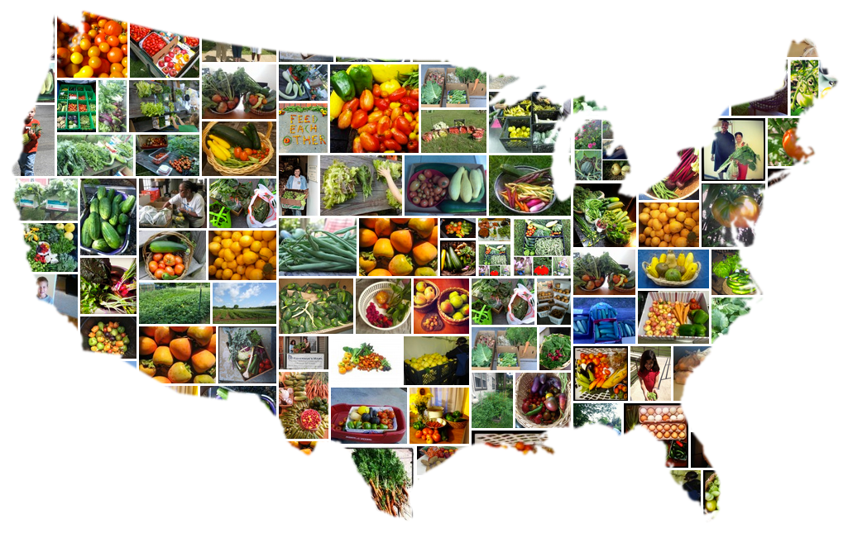
An Innovation:
Join Us
Nourishing – Not Just Feeding America
www.AmpleHarvest.org/support
Notes:
Jamie Oliver – TED speaker
First Lady Michelle Obama – Lets Move
Michael Pollan – Author
For the millions of Americans who can’t afford healthier eating, ampleharvest.org is enabling what they advocate

